Slide 1

Student Programs Year End Assessment Data

Slide 2
WISD Student Instructional Goals
Notes:
Washtenaw Intermediate School District (WISD) will administer a variety of assessments to all of their students three times during the 2021/2022 school year - in the first nine weeks of the school year, mid-year by February 2022, and again prior to the last day of school. Formative assessments will provide information to inform our progress toward our goals over the course of the year. Progress reports on our goals will be presented to the WISD Board of Education in February 2022 and June 2022. As a means of continuous improvement in teaching and learning, teachers will receive professional development in, and be committed to the use of, the formative assessment process. The goal that the WISD has set for their student population for assessment growth is 5 - 10% from baseline data to June 2022 data.

Slide 3
Goal 1
All children (birth- 3) within our Early Intervention Programs will increase developmental skills which will be monitored at periodic (six-month reviews) and annual reviews focusing on functional routines-based outcomes as evidenced by
  Parent Report and Observations
  Satisfaction with Home Routine Evaluations (SHoRE)
  Individualized Family Service Plan (IFSP) Outcomes

Slide 4
Early Intervention Data
\

Slide 5
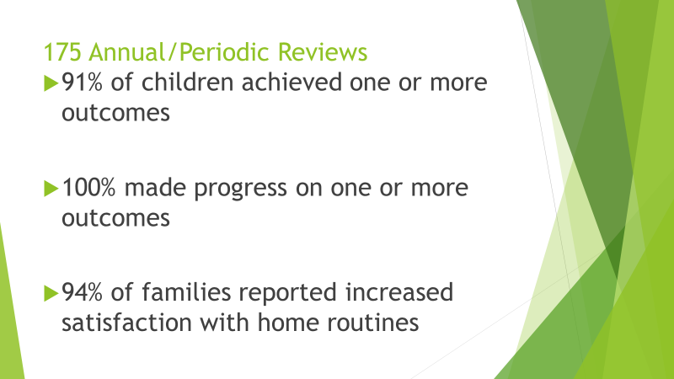

Slide 6
Goal 2
All students (K-12) will improve performance in Reading/ELA from Fall 2021 to Spring 2022 as measured by applicable assessments described below.
  All students (grades K-3) within our Center-Based Programs (CBP) and Local-Based Classrooms (LBC) will improve performance in literacy/ELA skills as measured by the Individual Reading Improvement Plan (IRIP).
  All students (grades 3-12) within our CBP and LBC will improve their performance in emergent reading skills measured by the Reading Behavior & Literacy Checklist and the Literacy Assessment Screening Assessment for Pre-verbal Students with severe cognitive impairment (SCI).
  All students (grades K-2) within our Emotional Impairment Programs (EI) will improve performance in literacy/ELA as measured by the MDE Benchmark Assessments in Early Literacy and Mathematics.
  Students (grades 3-12) within our EI programs will improve performance in reading/ELA as measured by the NWEA.
  Students (preschool) within our Deaf and Hard of Hearing (DHH) Program will improve performance in literacy/ELA as measured by the CID Early Childhood Vocabulary Rating Form, First 100 Words.
  Students (K-8) within our Deaf and Hard of Hearing (DHH) Program will improve performance in reading/ELA as measured by the CID Early Childhood Vocabulary Rating Form, First 100 Words, Reading A-Z Decoding and Comprehension, Tennessee Kindergarten Assessment of Phonological Awareness, CORE Phonics Survey.
  Students (grades 6-12) within our Court Involved Youth (CIY) program will improve performance in reading/ELA as measured by the Edgenuity 20/20.

Slide 7
Goal 3
All students (K-12) will improve performance in Mathematics from Fall 2021 to Spring 2022 as measured by applicable assessments as described below.
  All students (grades K-12) within our CBP and LBC will improve performance in mathematical skills as measured by the Learning Trajectories for Primary Grade Mathematics.
  All students (grades K-2) within our EI programs will improve performance in literacy/ELA & math as measured by the MDE Benchmark Assessments in Early Literacy and Mathematics.
  All students (grades 3-12) within our EI programs will improve performance in mathematics as measured by the NWEA.
  Students (preschool) within our DHH Program will improve performance in mathematics as measured by
  Students (K-8) within our DHH Program will improve performance in mathematics as measured by
  Students (grades 6-12) within our Court Involved Youth (CIY) program will improve performance in mathematics as measured by the Edgenuity 20/20.

Slide 8
High Point and CI Local-based Programs Data

Slide 9
HP/LBC Growth Data 2021-2022: Mid-Year
Assessment Given | Fall Data | Winter Data | Spring Data
Individual Reading Improvement Plan (IRIP) - classrooms | Ave Score 5.16 | Ave Score 7.77 | Ave Score 7.7
Bridge Foundations of Reading | Ave Score 10.6 | Ave Score 4.9 | Ave Score 5.9
Bridge Foundations of Writing | Ave Score 2.1 | Ave Score 3.1 | Ave Score 4.38
Bridge Alphabet Knowledge | Ave Score 1.3 | Ave Score 1.4 | Ave Score 3.69
Bridge Phonemic Awareness | Ave Score .57 | Ave Score .86 | Ave Score 2.69
2021-22 % Growth
Ave growth 33%
Ave growth 41%
Ave growth 48%
Ave growth 35%
Ave growth 51%

Slide 10
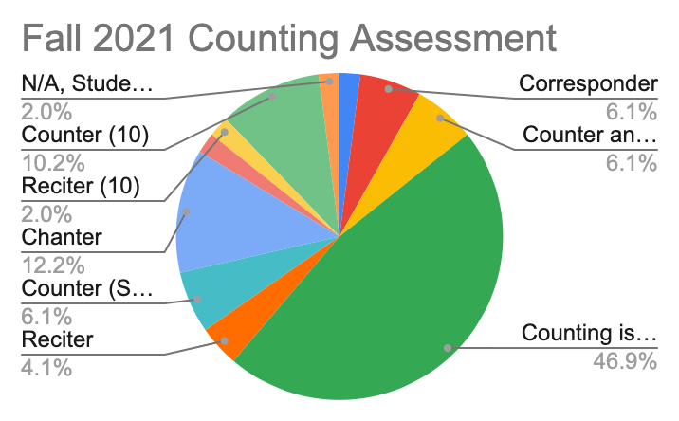

Slide 11
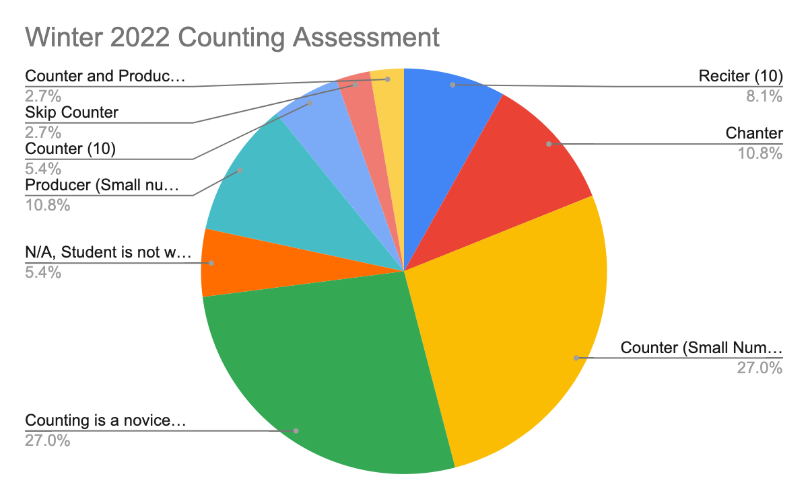

Slide 13
Deaf and Hard of Hearing Program Data

Slide 16
N=124

Slide 17
DHH student voice:
“Hi Sandy! I really enjoyed meeting him it was awkward just cause we have never met but hearing him talk it seems we have some things in common more than just hearing loss. I wasn't great at talking but I think if I talked to him more with you as extra help with conversations at first I think I could even become friends with him if he wants to as well, he seems like a good kid even though I don't know much about him.
Thank you for giving me the opportunity to meet him and potentially others with hearing loss, Sincerely (DHH Student)”

Slide 18
Progress Park and EI Local-based Programs
Year End Data Analysis
Julie Voelker
EI LBC/Progress Park
Notes:
We have not seen as much growth at Progress Park and our Local-based EI Classrooms. Both of these programs are for students struggling with emotional dysregulation and their mental health often affects their assessment taking abilities. We have had several students hospitalized this year due to their mental health as well as several staff and students out with COVID over the past month.

Slide 19
Overall Student Growth for Progress Park (PPK) & EI Local Based Classrooms (EI LBC)
Goal: 5% student growth across 85% of students.
Measures: NWEA Math, NWEA Reading, Success Maker Math, Success Maker Reading, and Ilit Reading.
Average Percent of Students with 5% Growth: 82.39%
Median Growth: 73.37%
Level: Indicates a moderate-high in relation to the goal.

Slide 20
Alternative Goals: Consideration for the way in which the original goal was written should be taken. The original goal was worded in a way that limited the outcome and did not show a true representation of the data.
Goal: 85% of students will show 5% growth on NWEA OR in Success Maker for math and reading.
Outcome: 100% of students achieved 5% growth on NWEA or in Success Maker for math and reading.
Goal: On average, students will show 5% growth across measures (NWEA and Success Maker).
Outcome: On average students made 23.84% growth across measure (NWEA and Success Maker).

Slide 21
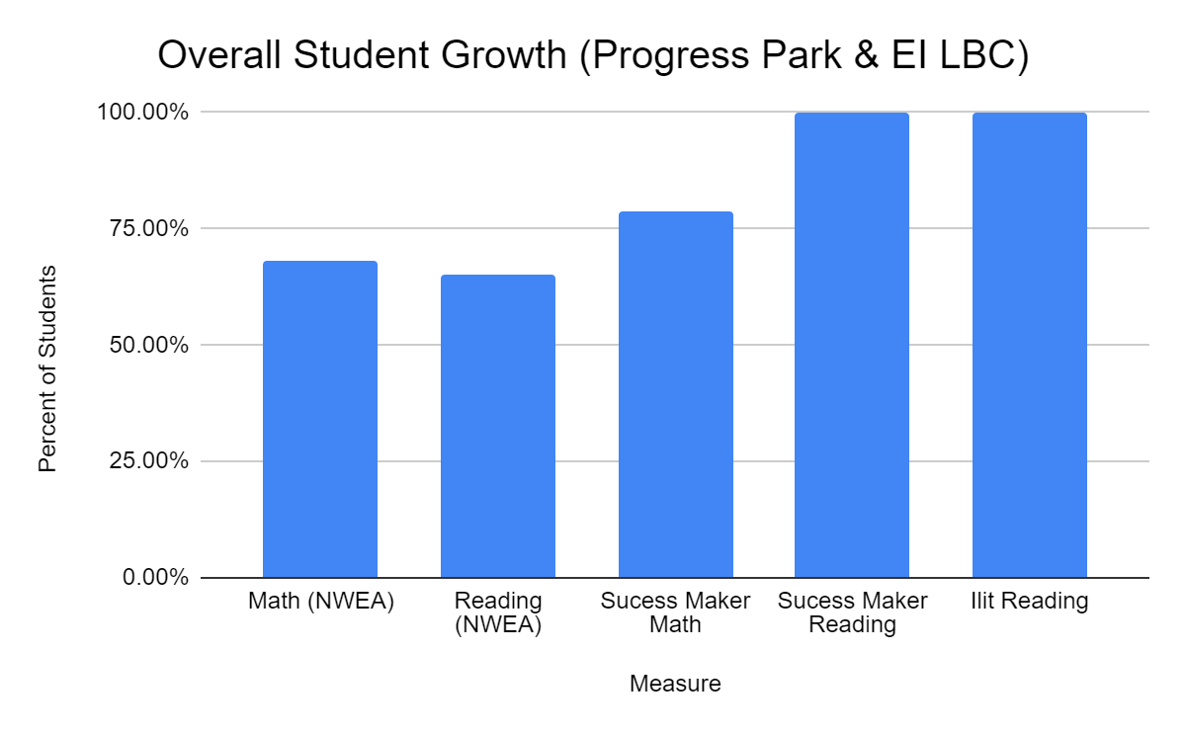
Overall Student Growth for PPK & EI LBC
Notes:
INSERT GRAPH

Slide 22
Overall NWEA Math for PPK & EI LBC
Average percent of students to make 5% growth: 71%
Median percent of students to make 5% growth: 60%
Level: Indicates that scores are at a moderate level of growth toward the goal.

Slide 23
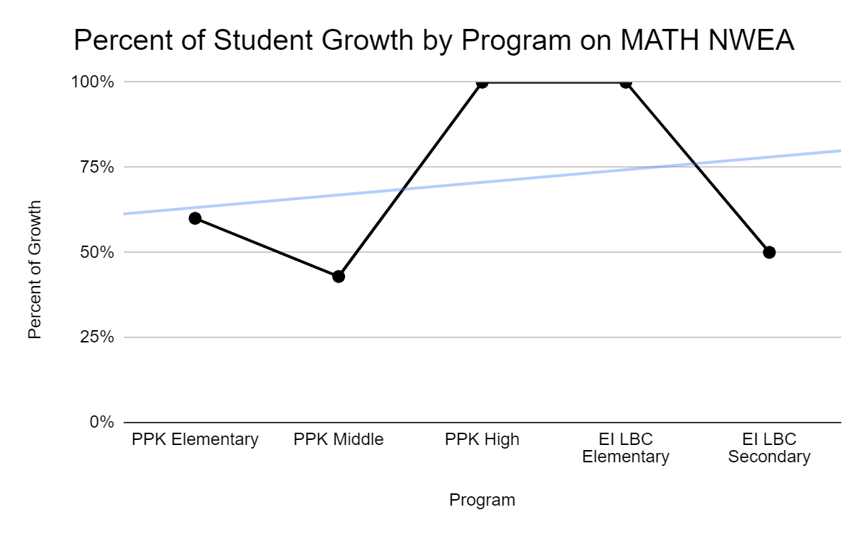
Percent of Student Growth by Program on Math NWEA

Slide 24
Overall NWEA Reading for PPK & EI LBC
Average percent of students to make 5% growth: 82%
Median percent of students to make 5% growth: 83.75%
Level: Indicates that scores are at a high level of growth in relation to the goal.

Slide 25
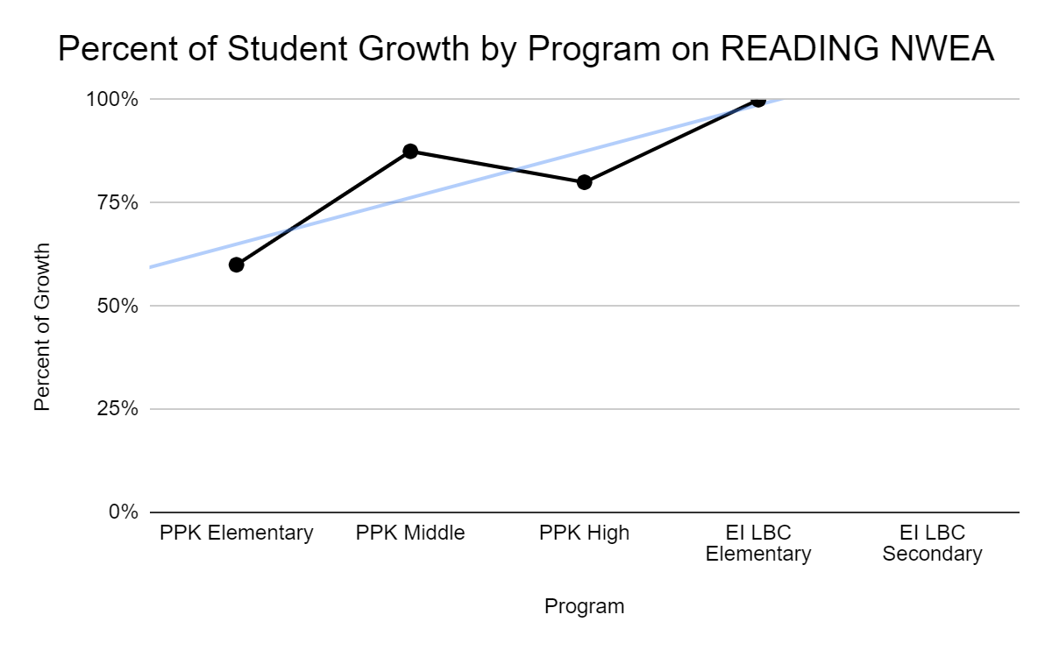
Percent of Student Growth by Program on Reading NWEA
EI LBC not included due to chronic absences.

Slide 26
Overall Student Growth for PPK & EI LBC in Success Maker Math
Average percent of students to make 5% growth: 89%
Median percent of students to make 5% growth: 66.7%
Level: Indicates that scores are at a moderate-high level of growth in relation to the goal.

Slide 27
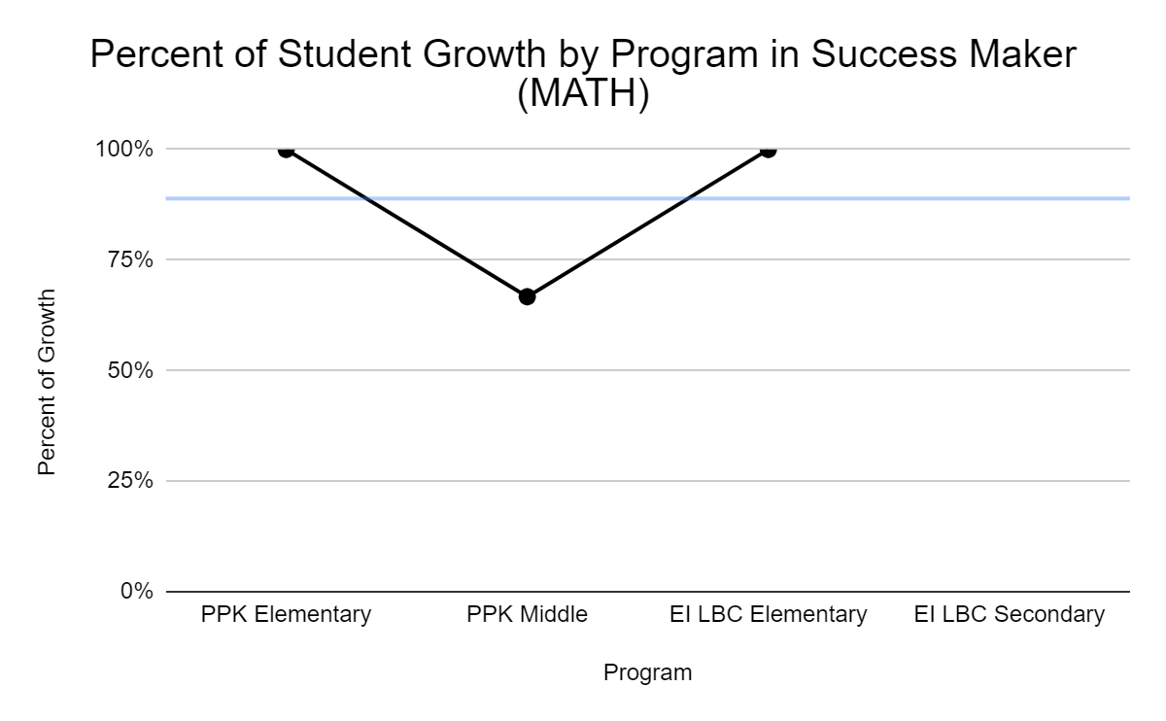
Percent of Growth by Program in Success Maker Math

Slide 28
Overall Student Growth for PPK & EI LBC in Success Maker/iLit 20 Reading
Average percent of students to make 5% growth: 97%
Median percent of students to make 5% growth: 100%
Level: Indicates that scores are at a high level of growth in relation to the goal.

Slide 29
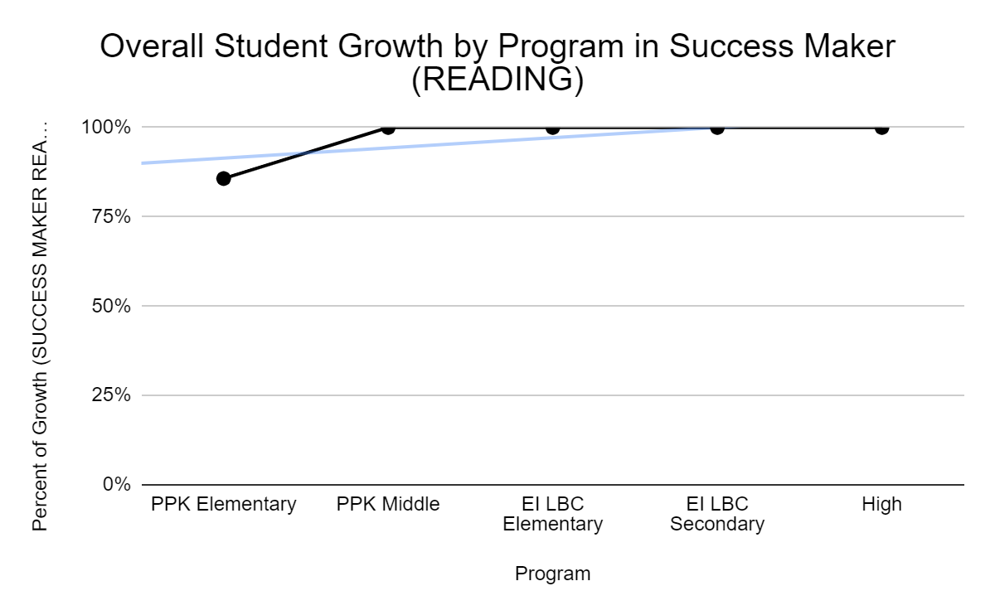
Percent of Student Growth for PPK & EI LBC for Success Maker/Ilit Reading
Notes:
Insert Graph

Slide 30
Court Involved Youth Program Data

Slide 31
We do not have the same students in the program at the end of the year as those who were in the program at the beginning of the school year, so we are not able to make comparisons and determine growth for this program.
Notes:
We are able to look at each individual student in the program and assess their skills. We can then use that information to make teaching and learning adjustments.

Slide 32
Goal 4
All students (18- 26 years old) within our Young Adult Programs (YA) and Young Adult Project (YAP) will improve performance in functional transition skills as measured by the Washtenaw Intermediate School District Comprehensive Transition Assessment.
  All teachers will use the formative assessment process to support adjustments to meaningful student progress towards mastery of transition goals.
  Results from transition benchmark assessments, local transition summative assessments, and formative assessments will be continuously discussed and analyzed by staff.

Slide 33
Low Incidence

Slide 34
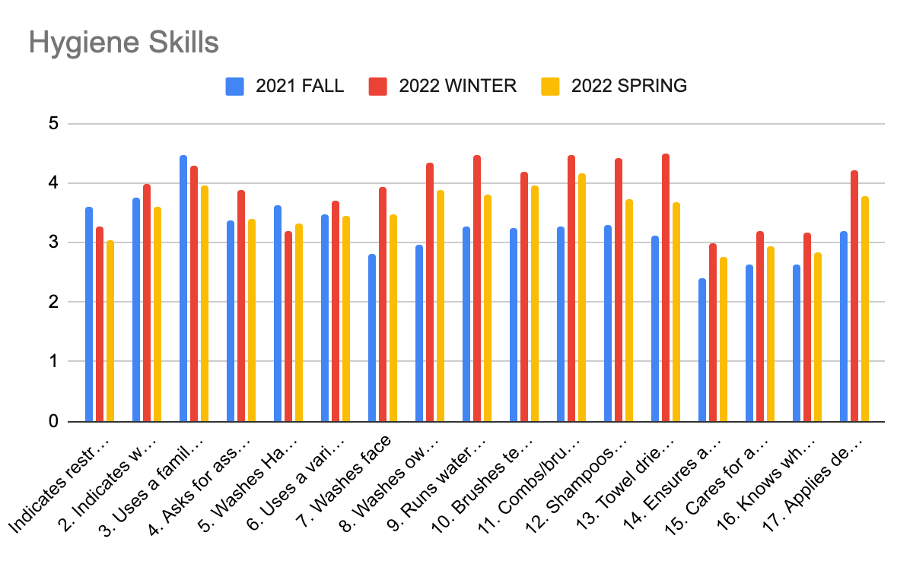

Slide 35
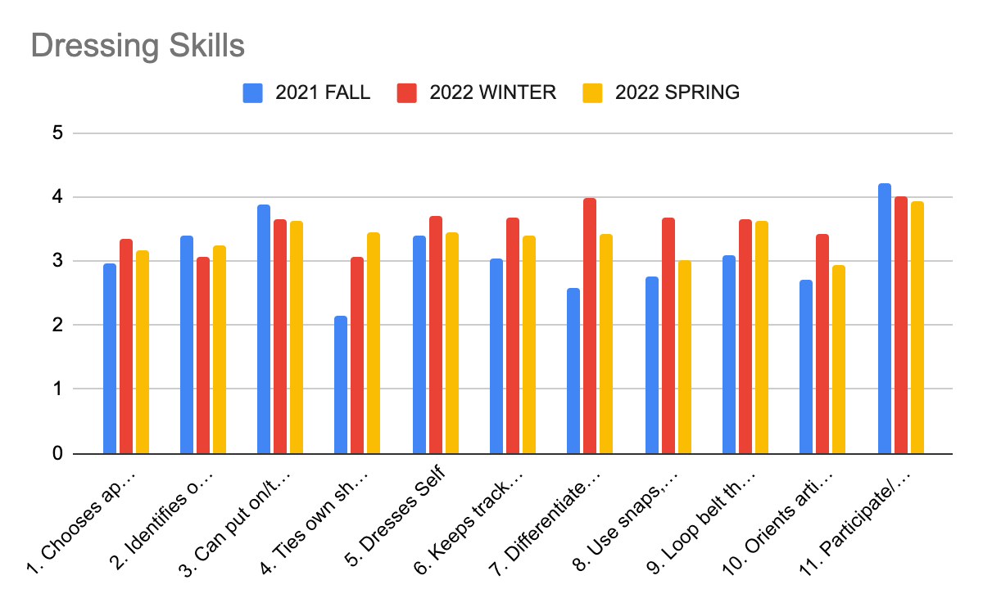

Slide 36
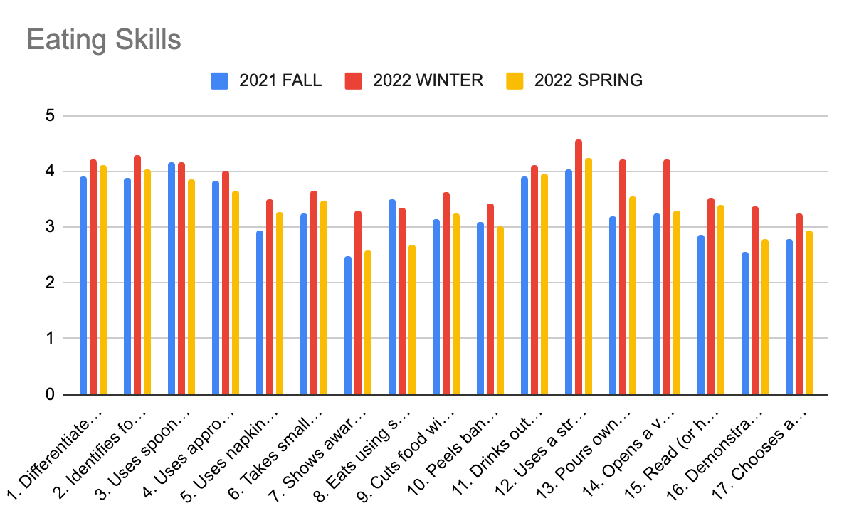

Slide 37
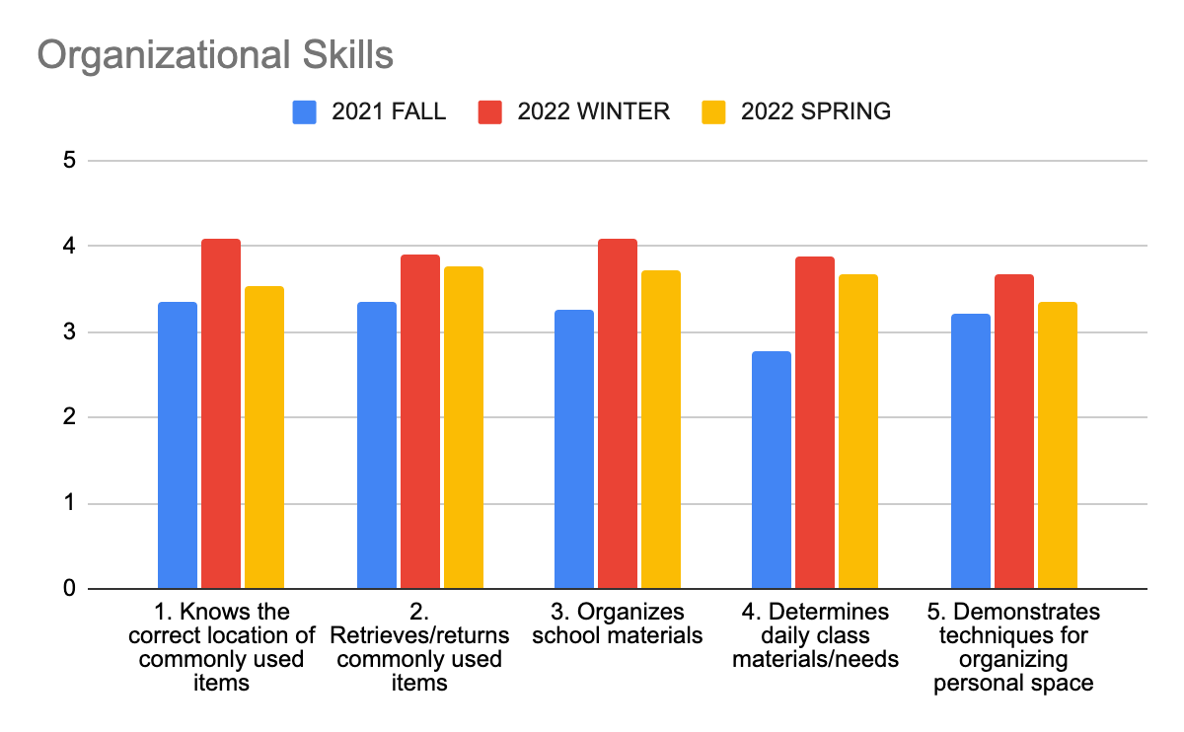

Slide 38
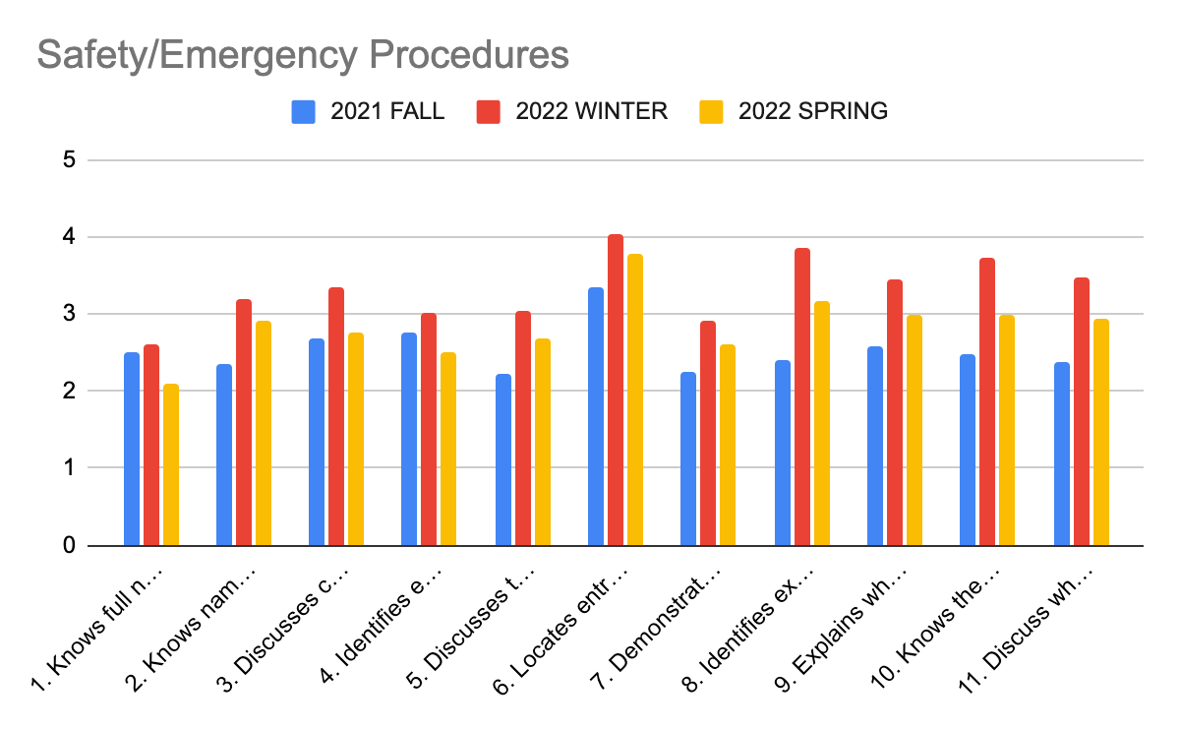

Slide 39
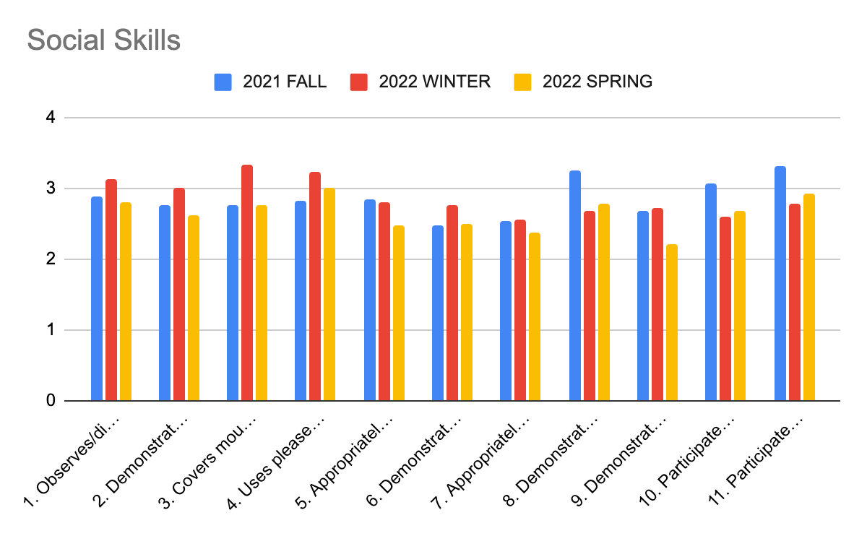

Slide 40
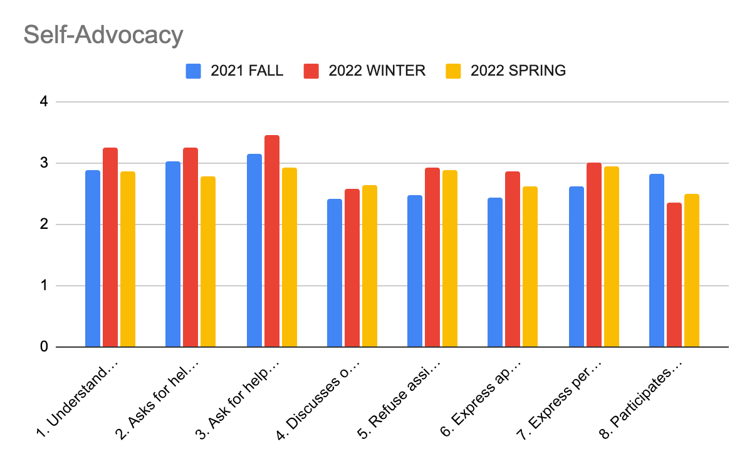

Slide 41
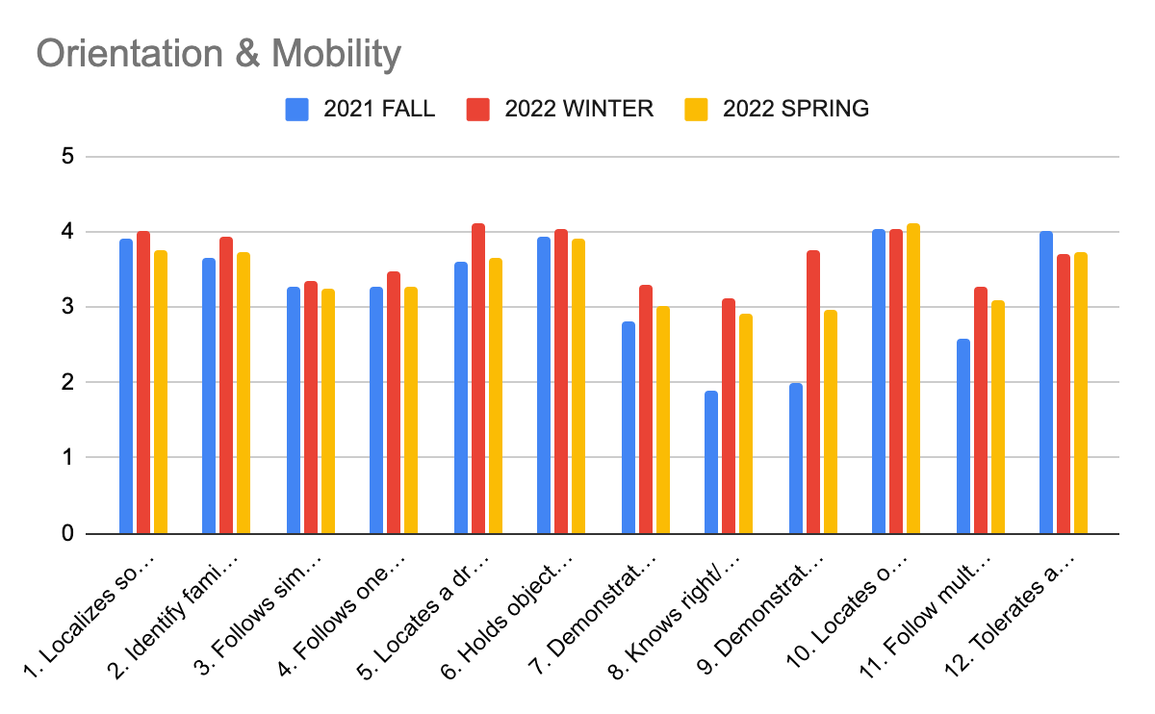

Slide 42
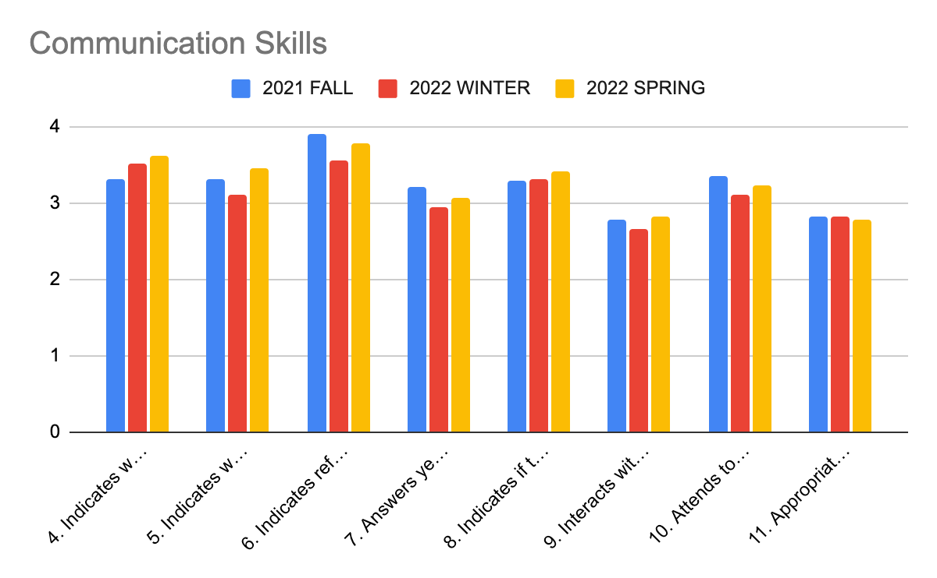

Slide 43
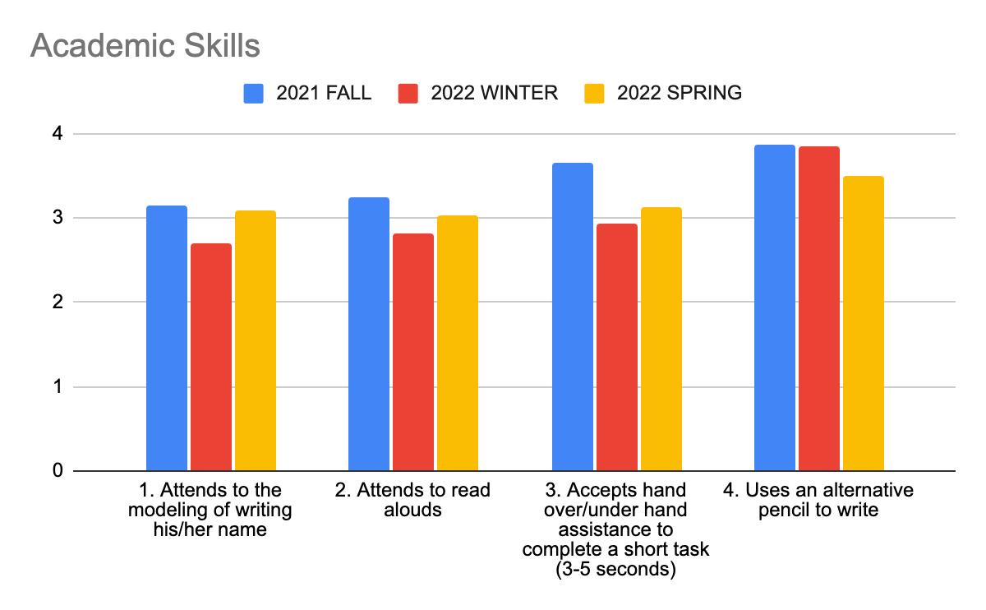

Slide 44
Red Oak Young Adult

Slide 46
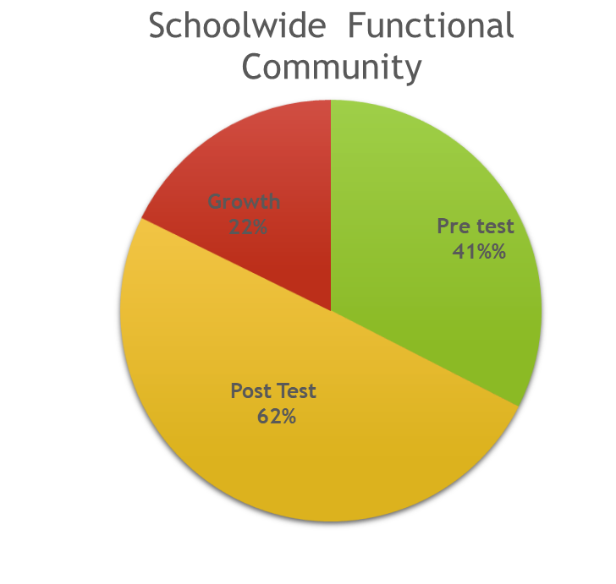

Slide 50
Young Adult Programs and Services Data

Slide 51
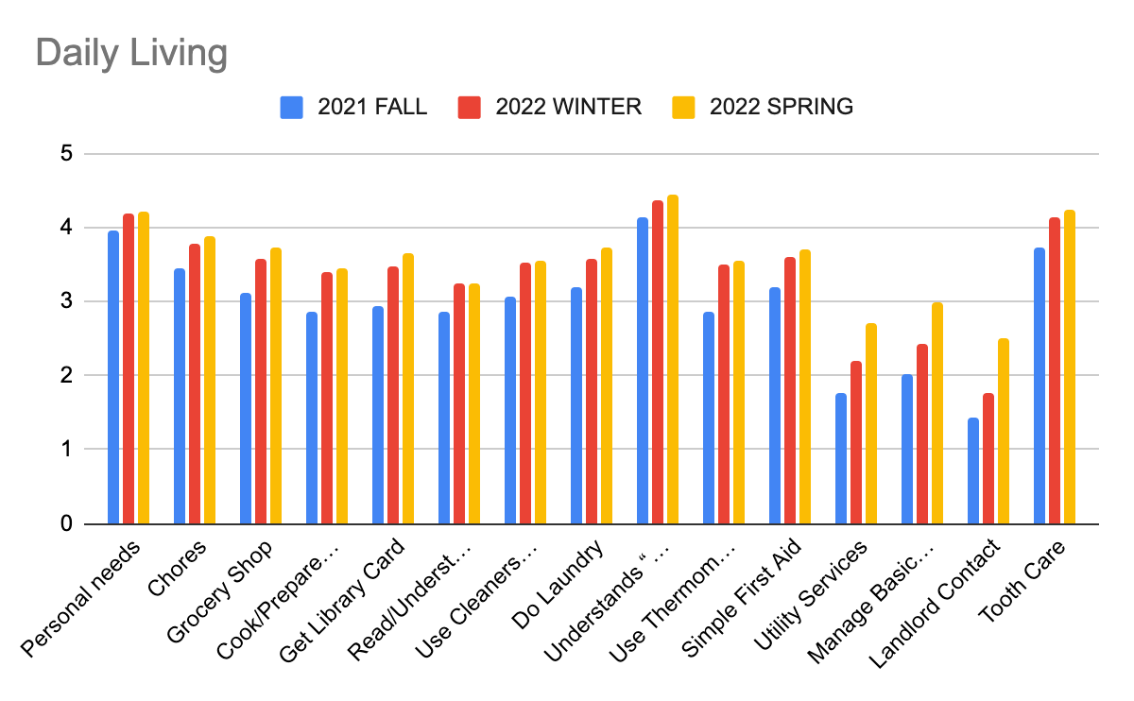

Slide 52
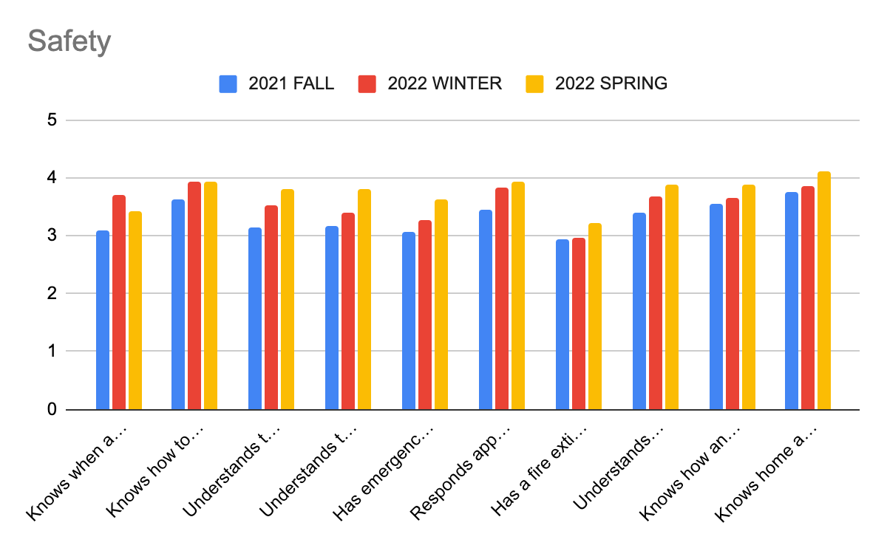

Slide 53
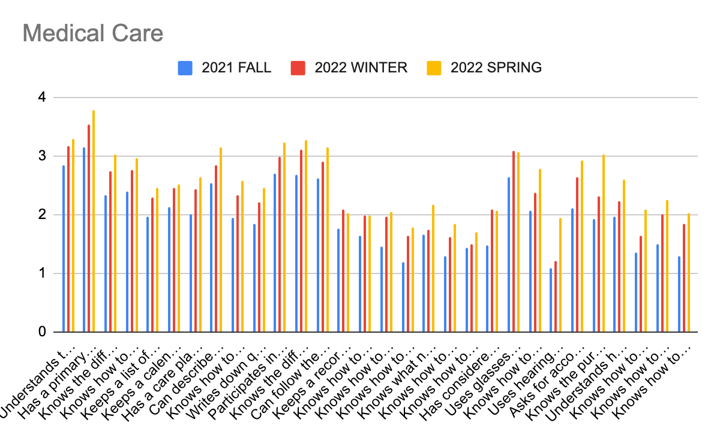

Slide 54
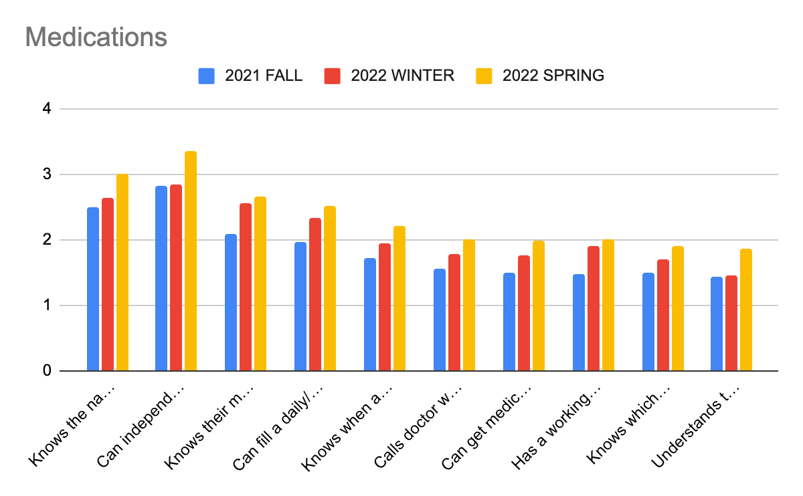

Slide 55
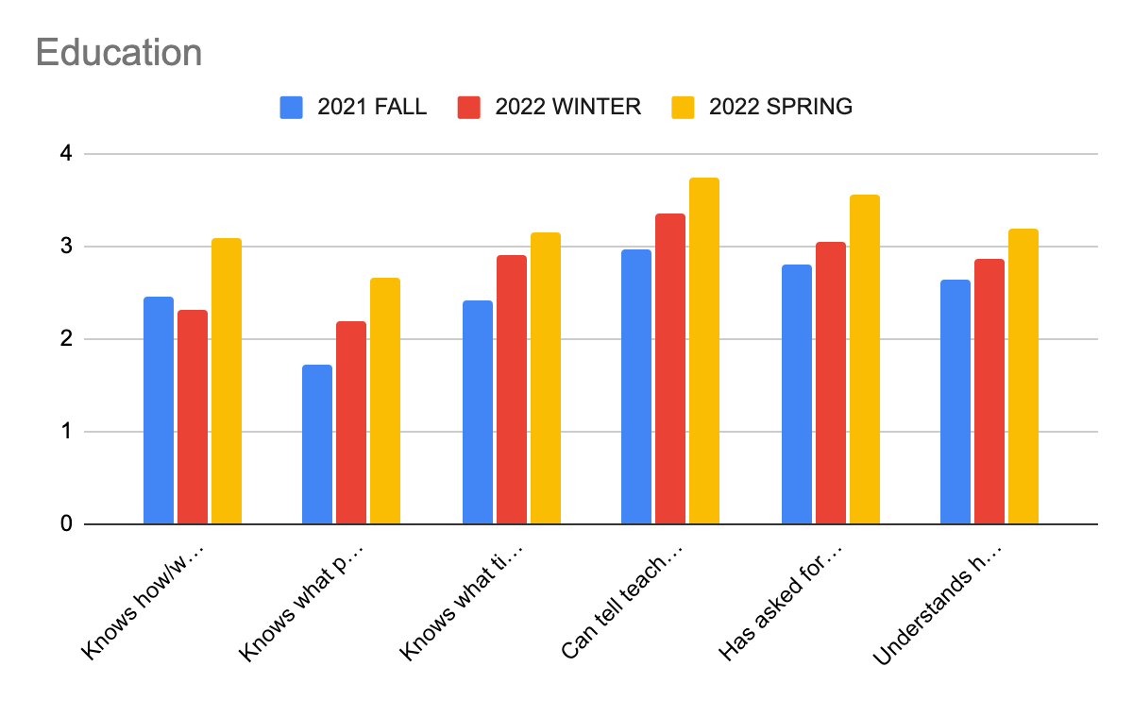

Slide 56
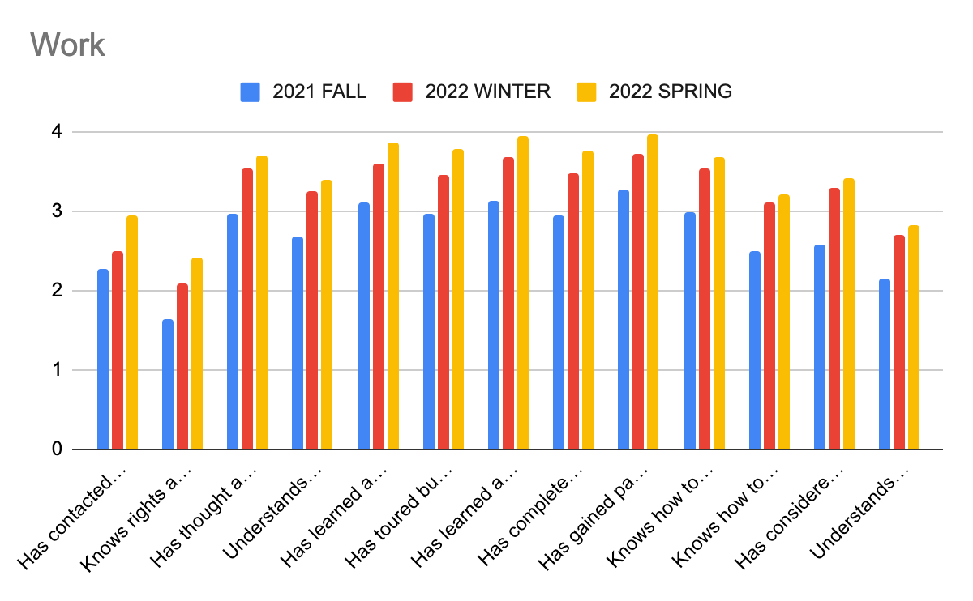

Slide 57
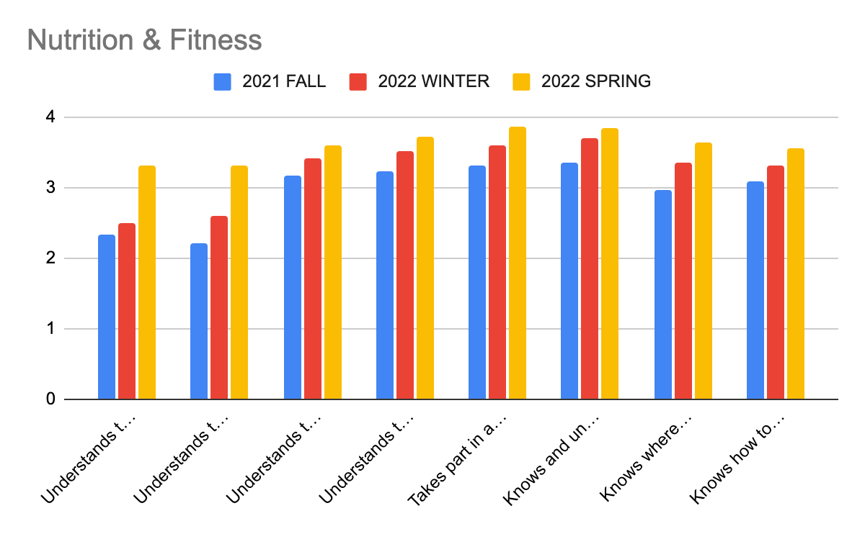

Slide 58
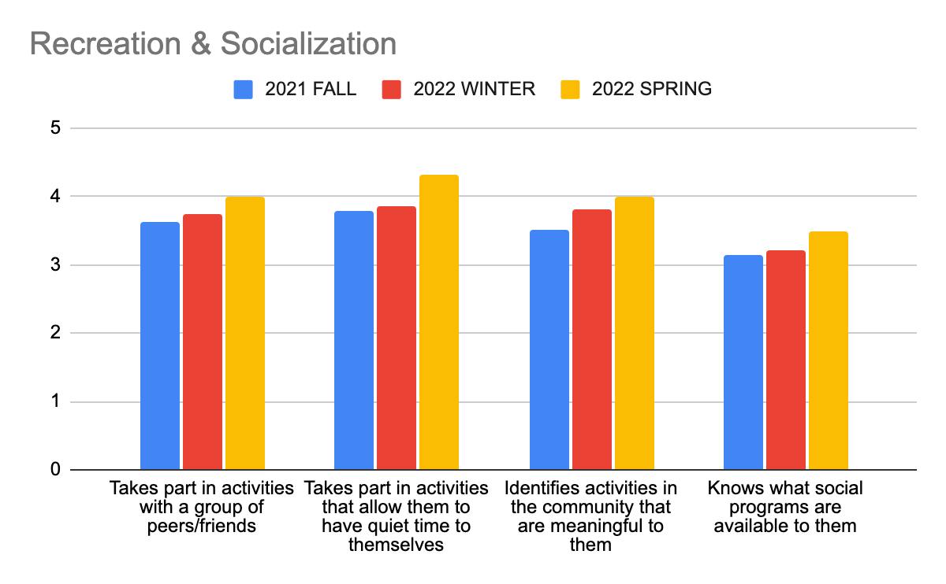

Slide 59
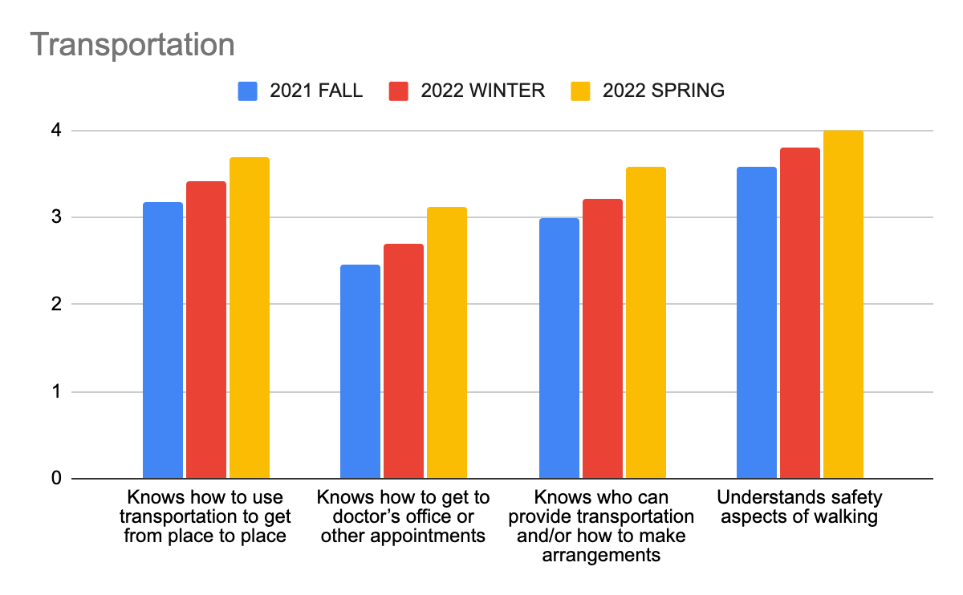

Slide 60
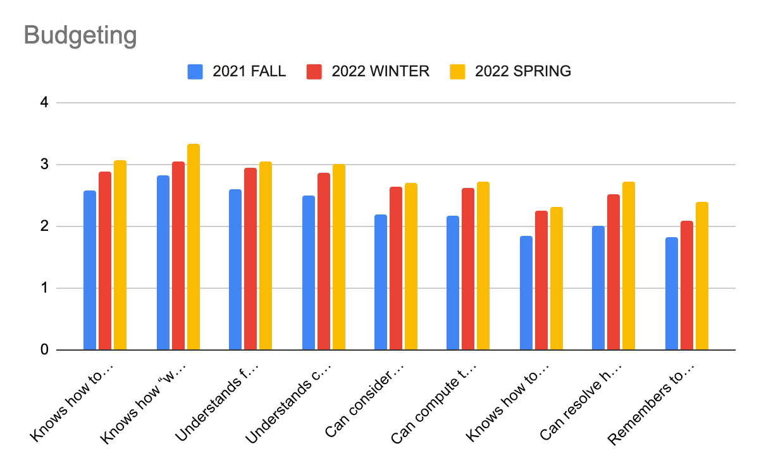

Slide 61
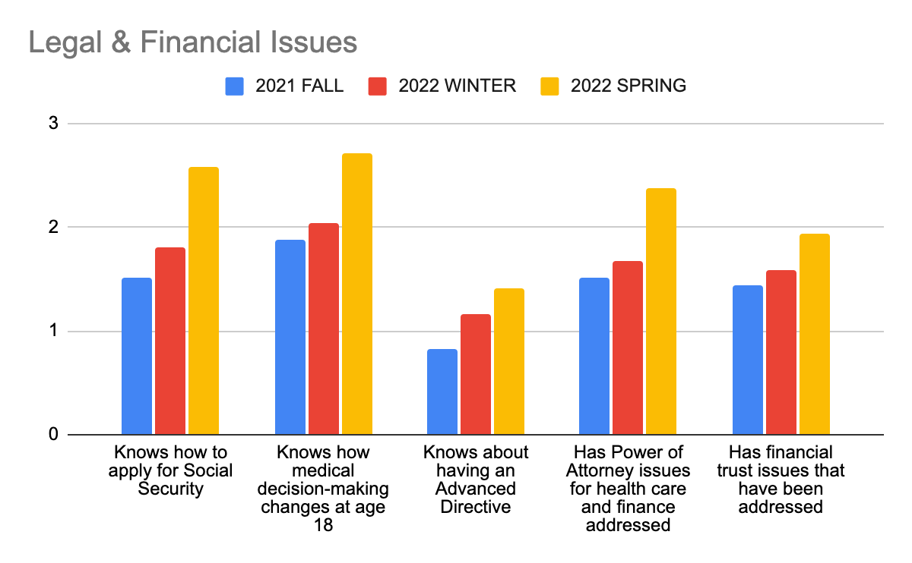

Slide 62
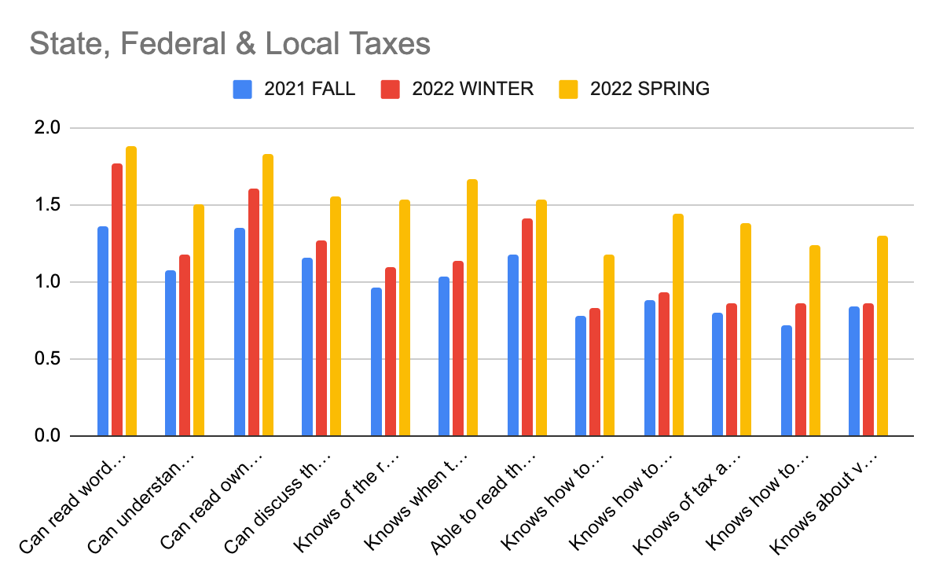

Slide 63
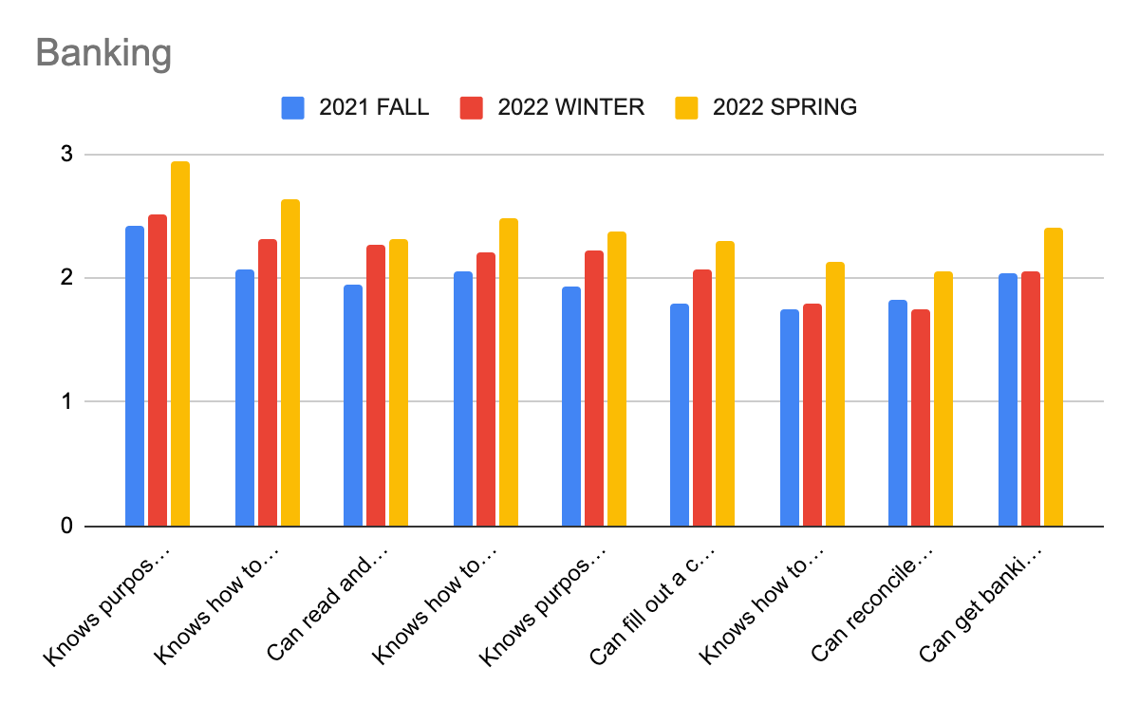

Slide 64
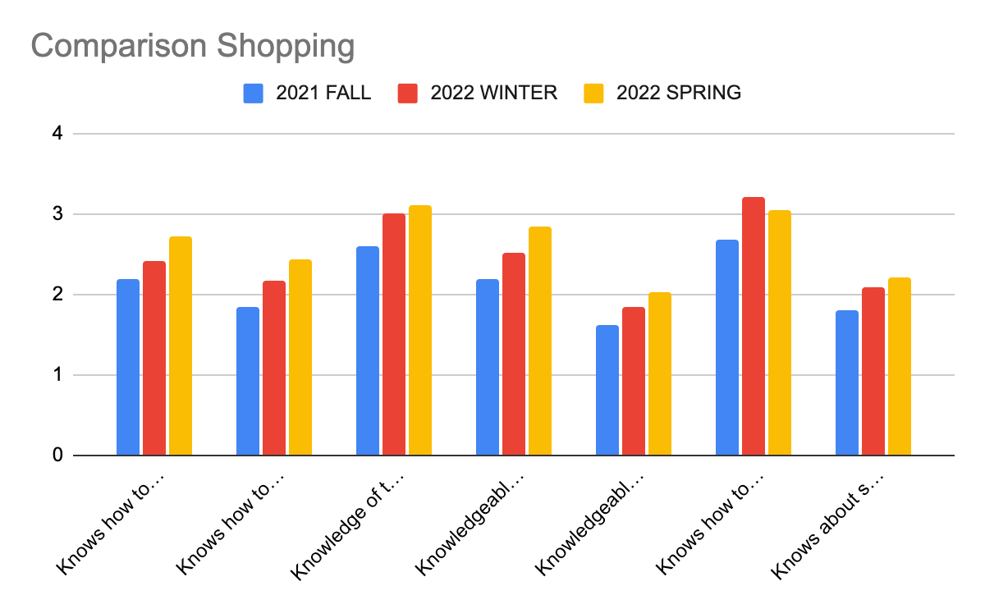

Slide 65
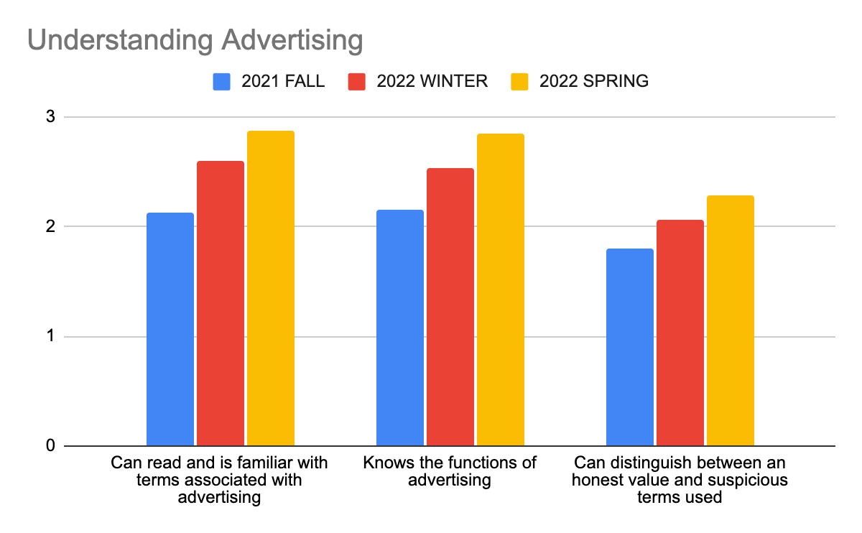

Slide 66
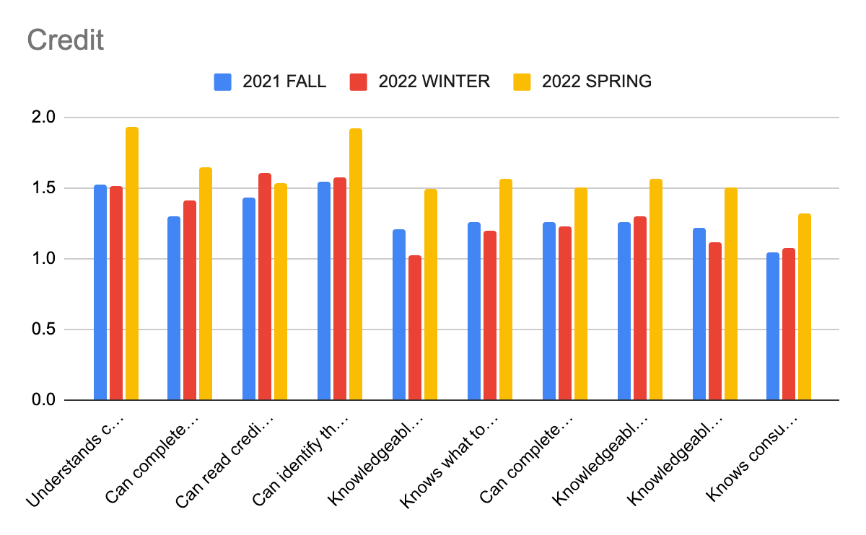

Slide 67
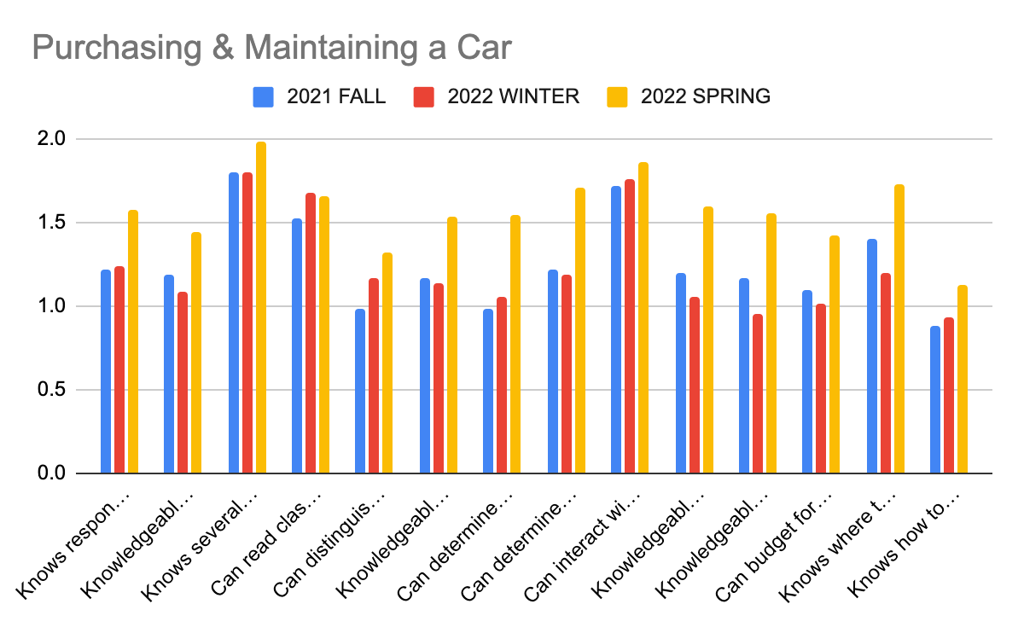

Slide 68
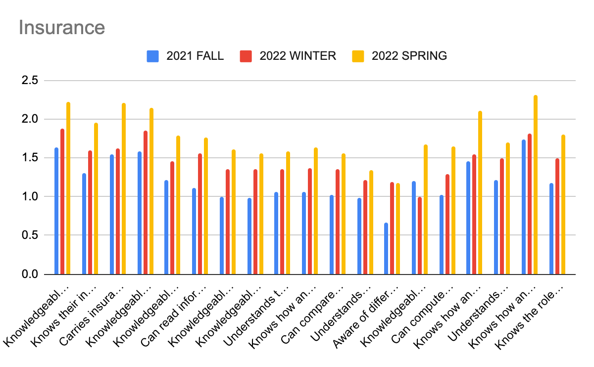

Slide 69
Young Adult Project Growth data included in district transition data

Slide 70
Young Adult Project
Outcome Data
Mark's Lawn Care
J.Tech
Holidays
Polly's
Urban Outfitters
A2 Ice Cube
Dicks Sporting Goods
Meijer
Chelsea Hospital
Tractor Supply
Work and Play Café
Riverview Café
Little Diablo
Liberty Tax Service
ZF Axel
EMU DC1
WISD
Popeye's Chicken
Barber, self employed
Burger King
Manchester Market
EMU Student Center
MMI Engineering Solutions
Huron Hills
Little Caesars Pizza
JR's Restaurant
Old Navy
Regent Hotel
TJ Maxx
73% of students have competitive employment (at Spring snapshot)

Slide 71
YAP student voice:
“I writing to tell you that Dawn Keith is the most amazing teacher that I ever had. She help me renew my drivers license. She’s helps me with the calendar. She helps me fill out papers when I need help. In conclusion Dawn Keith is the most amazing teacher to have.”
-YAP student

Slide 72
Jail Services
Four students have received diplomas this year.

Slide 73
NOTE
Student data was not disaggregated by race or socioeconomic status because our student numbers are so low that it could do two things: disclose scores in an identifiable way or present data in a way that is not statistically appropriate.

Slide 74
Thank you

