Slide 1

Special Olympics Michigan

Slide 2

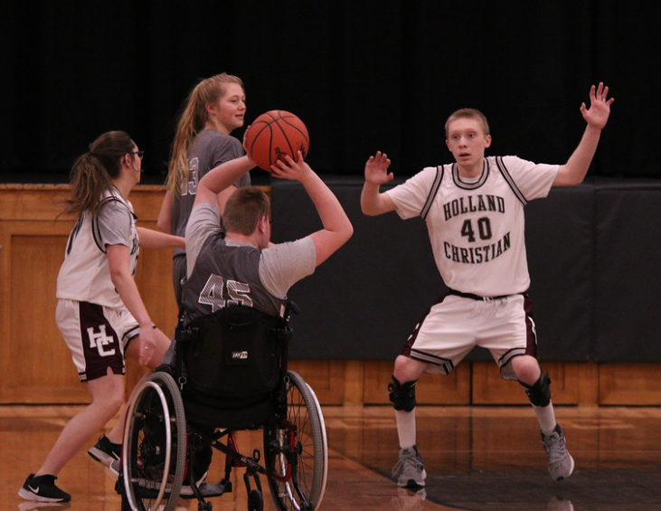
What is a Special Olympics Unified Champion School?
Special Olympics Unified Champion Schools bring together students with and without intellectual disabilities through education, sports, and youth leadership to provide them with the knowledge, attitude, and skills necessary to create and sustain school communities that promote acceptance, respect, and human dignity.

Slide 3

Special Olympics Unified Champion School Facts
530 Unified Champion Schools in Michigan (K-12) and the number keeps growing
42 counties with UCS participation
More than 7,000 schools nationwide participate!

Slide 4
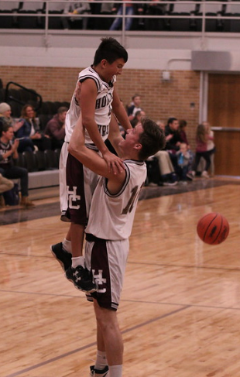
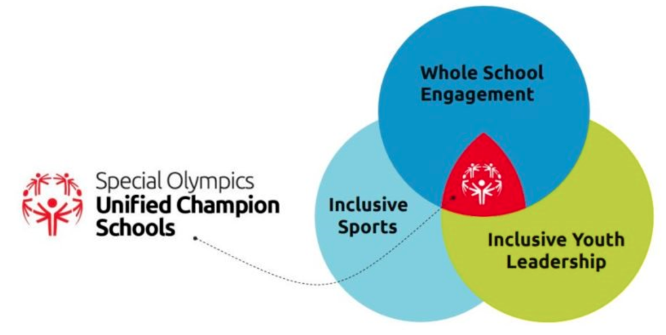
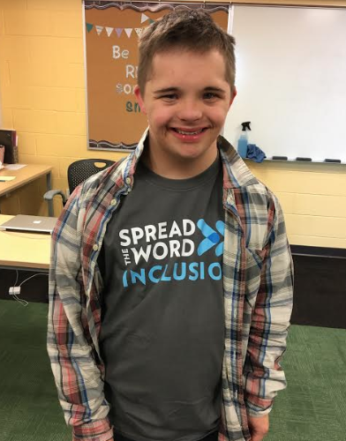
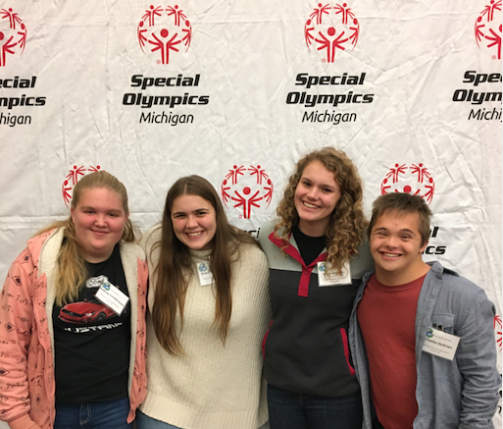
Unified Champion School Key Characteristics

Slide 5
Key Terms
Unified-Students with and without disabilities participating together
Athlete- a student with a disability participating in Unified program
Unified Partner- a student without a disability participating in Unified programming
Liaison- an adult in the school district that is Special Olympics main point of contact

Slide 6
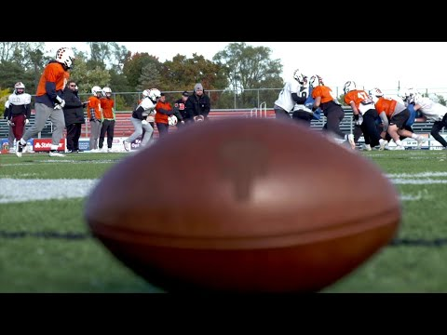


Slide 7
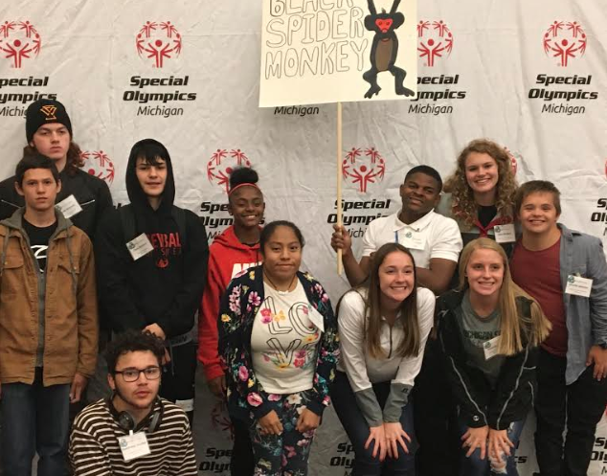
Inclusive Youth Leadership
A Youth Activation Committee (YAC) consists of youth leaders with and without intellectual disabilities who strategize and plan activities. The YAC takes responsibility for the promotion and sustainability of the inclusive program.
There are school, state and national level YAC committees.
Notes:
Elementary - young readers, partners leading warm-ups, line leaders, working STW table, students helping with Unified field day
Middle/High School - young readers, students lead sports club, start a Unified team or program at younger level, peer to peer, plan spirit week and other activities

Slide 8
Whole School Engagement: Welcoming for All
Whole School Engagement activities positively impact school climate by including all students, teachers, staff, and administrators.
An inclusive school climate that fosters understanding and respect for all can influence how students think and act within and beyond the school environment.

Slide 9
Why is Whole School Engagement important?
Teaches staff and students to embrace diversity
Expands ownership of the Unified Champion Schools program beyond a small group of students and staff
Creates a climate where students staff feel safe and valued
93% of students exposed to UCS and campaigns have improved their behavior and attitudes towards people with intellectual differences
86% of UCS staff credit the program with reducing bullying and teasing in their school.

Slide 10
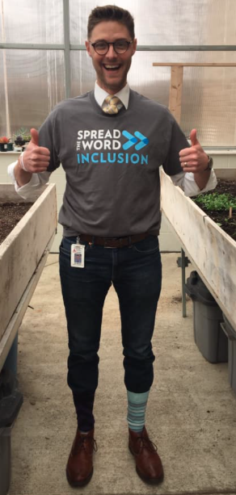
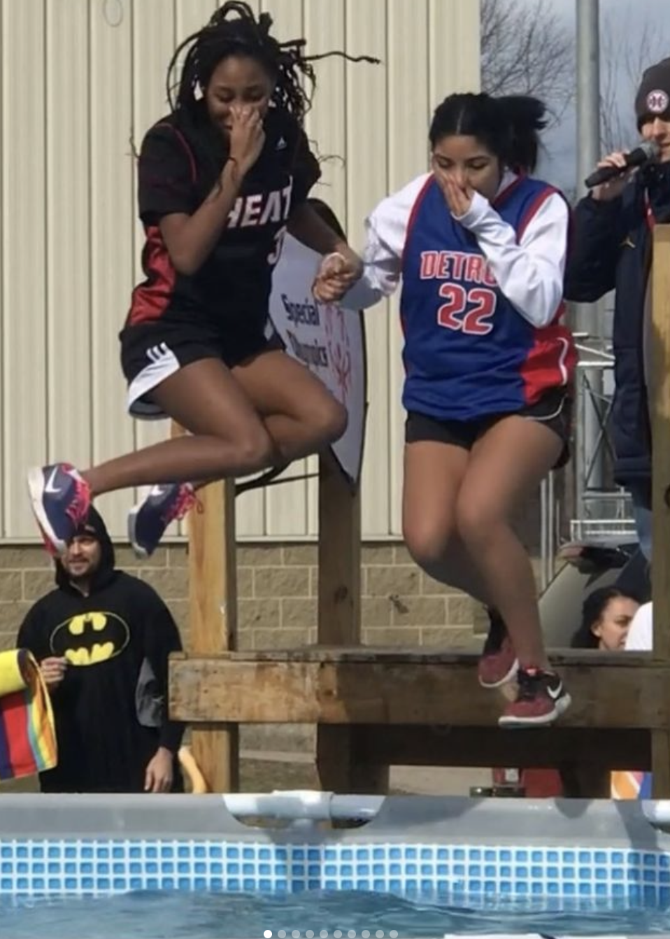
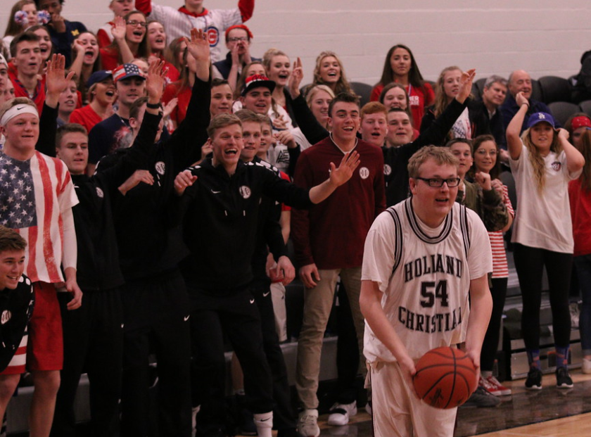
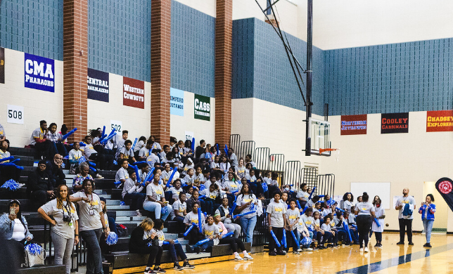
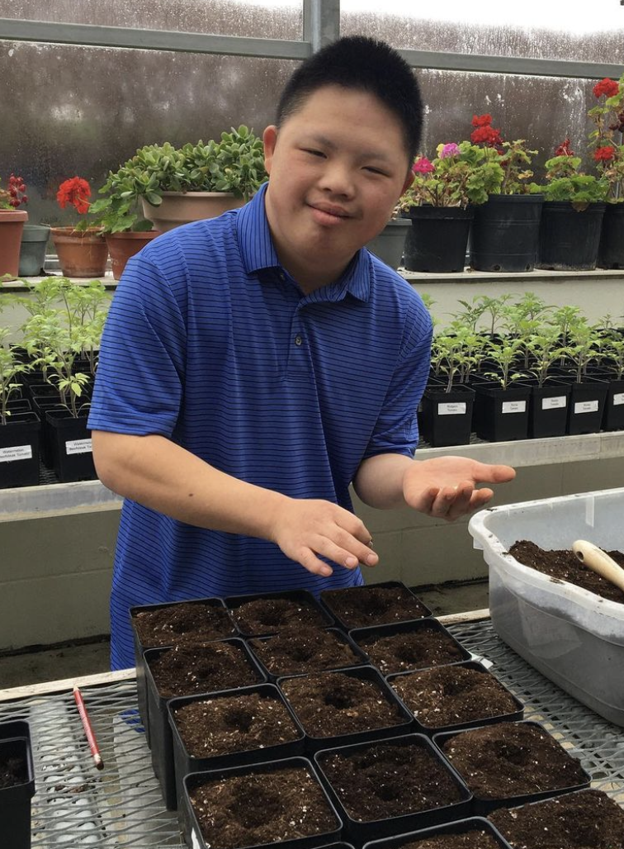
Whole School Engagement Activities
Fans in the Stands
Polar Plunge
Awareness Campaigns
More Ideas:
Morning announcements, anti-bullying campaign, exhibition game at half-time, before/after a varsity game, posters, clap out, assembly (staff/student game)
Assemblies
Fundraisers

Slide 11
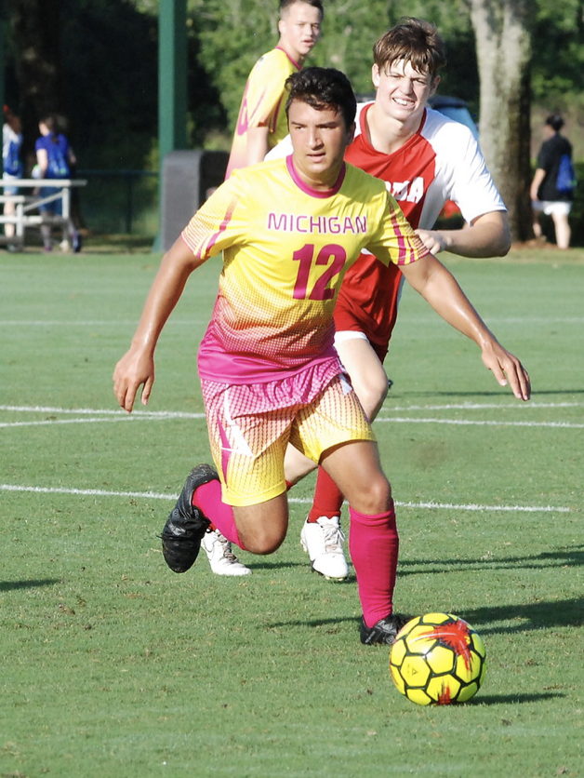
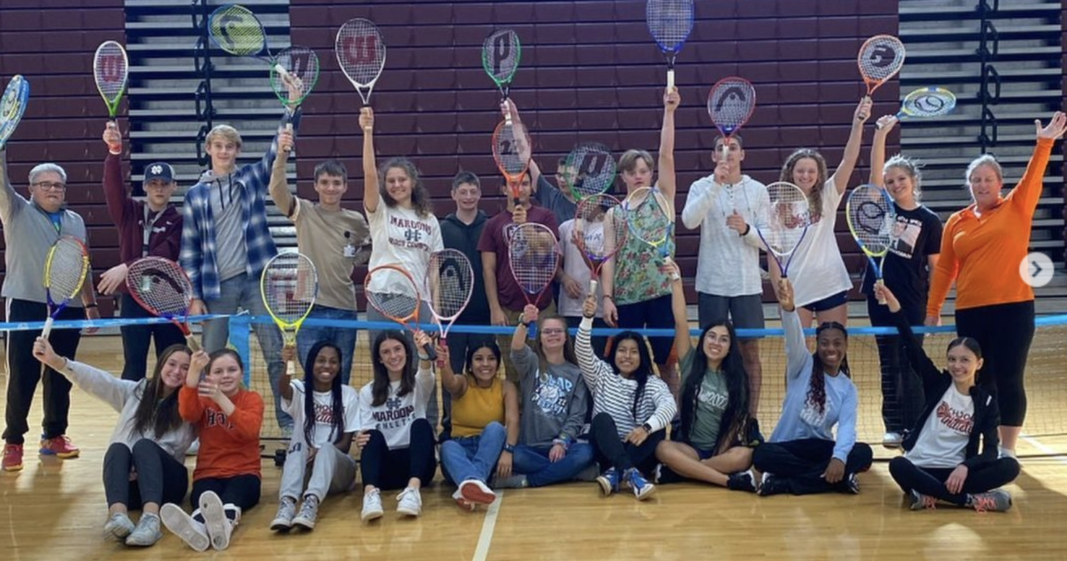
Inclusive Sports
Unified
Sports
Unified
PE

Slide 12
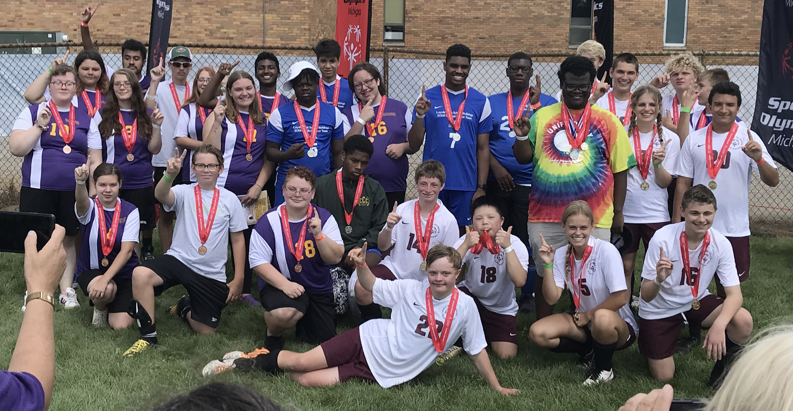
What is Unified Sports?
Unified Sports is an inclusive sport program that combines an approximately equal number of athletes (people with intellectual disabilities) and partners (people without intellectual disabilities) on teams for training and competition.
Considered the same as any other sport in your school.
All athletes and partners are meaningfully involved.
Can be competitive or recreational

Slide 13
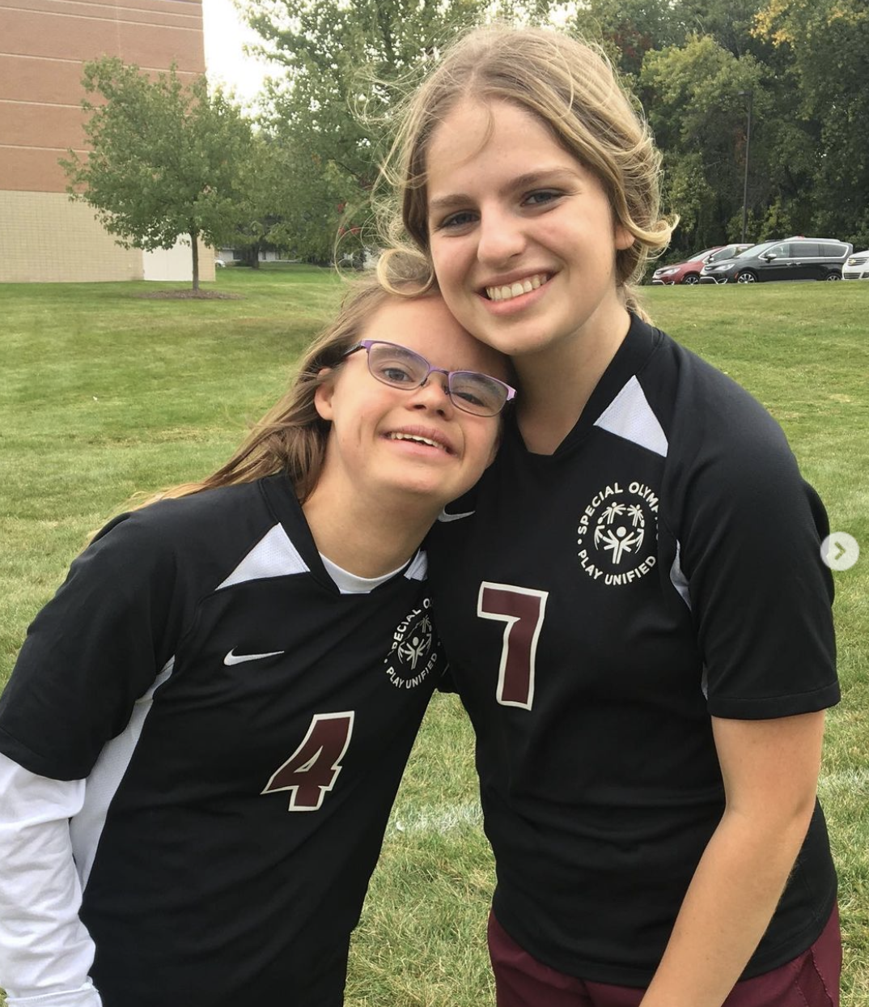
Why Unified Sports?
Unified sports creates unique teammate bonds through sports experiences just like any other sports team.
Leads to new friendships, improved self-esteem, and positive changes in attitude, behavior, and performance for all students involved.
The program creates a lasting impact on all those participating.

Slide 14
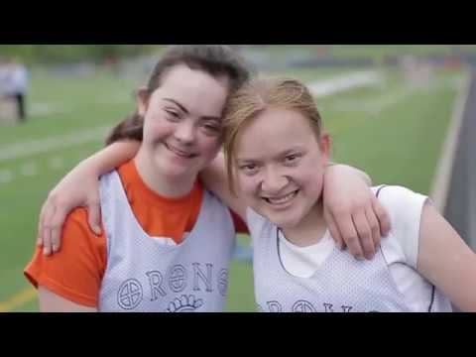

Slide 15
How do I get started??
Designate someone to be the Special Olympics liaison
Get approval from your school Administrator
Create a Leadership team to help
Go to www.SOMI.org/schools and fill out the UCS Interest Form (New Schools)
Create your school’s YAC
Decide on which sport/activities
Get your Athletic Director on board
Find schools in your area to compete against

Slide 16
SO College
Area 20 is Unique and has 2 Special Olympic Colleges in the Area.
You have U of M and EMU. Each has a program that runs year round with Sports.
Flag Football
Basketball
Swimming

Slide 17
Special Olympics Michigan
The mission of Special Olympics Michigan is to provide year-round sports training and athletic competition for children and adults with intellectual disabilities.

Slide 18
Special Olympics Michigan
Washtenaw County falls under Area 20 at the Traditional Sport Side of Special Olympics Michigan.
Your Area Directors are
Katy Fillion
Kristi Haywood
Jamie Baxter (Assistant AD)
They can get you started or on a local team. They can be reached at area20@somi.org

Slide 19
What is needed to be a SOMI Athlete?
Athletes are eligible to participate in Special Olympics from 8 yrs through adulthood.
Athletes must have an up to date medical packet and communicable diseases waiver on file to compete.
These can be sent to the Area Director (area20@somi.org) and they will get them into the State.
Link to Medical Packet (Good for 3 years)
Link to Communicable Diseases Waiver

Slide 20
What is needed to be a SOMI Volunteer?
Complete VMS (Volunteer Management System)
Attend practices with the area and be a volunteer while at State Games!

Slide 21
What is needed to be a SOMI Coach?
Complete VMS (Volunteer Management System)
Get certified in the Sport(s) that you plan on coaching
Fill out a seasonal roster and send it to area20@somi.org and they will send it to se.forms@somi.org
Fill out registration with Area 20 for the State Event of the season
Compete and HAVE FUN!!

Slide 22
Sports Offered in Area 20
Alpine Skiing
Athletics
Basketball
Bocce
Bowling
Cross Country Skiing
Figure Skating
Golf
Poly Hockey
Snowshoeing
Swimming
Volleyball

Slide 23
Thank you!
Q & A time!
Feel free to email us with any questions
julia.eory@somi.org (Area/ SO College Questions)
cathy.burr@somi.org (UCS Questions)
kevin. taegel@somi.org (Sports Questions)

