Slide 1

Pulos’ Career Awareness and Exploration Toolkit (P-CAET)
1
Joshua M. Pulos
University of Oklahoma

Slide 2
Overview
2

Slide 3
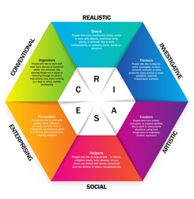
Overview
3
Pulos’ Career Awareness and Exploration Toolkit (P-CAET) is designed to help students with disabilities build awareness and exploration of different career pathways leading to entry-level jobs (i.e., an entry point into a specific chosen profession).
Based on John Holland’s structural theory of career development, Holland (Luft, 2012) touted an individual’s personality can be divided into six types corresponding with a variety of overarching thematic work environments: (a) Realistic, (b) Investigative, (c) Artistic, (d) Social, (e) Enterprising, and (f) Conventional (RIASEC). When aggregated, these are known as Holland’s Occupational Codes (e.g., RSC).

Slide 4
Overview
4
Individuals tend to have dominant personality patterns which fit into two or three common types. By utilizing Holland’s career development theory, the P-CAET can be used to determine an individual’s occupational matches.
It is important to note, with high person/environment correspondence (i.e., job match), work place satisfaction takes place, while with low person/environment correspondence, dissatisfaction takes place (Perkman, 2012).

Slide 5
Overview
5
All occupations within the P-CAET require low levels of education (i.e., no special training to a high school diploma or GED) to be successful; thus, all students with disabilities, ages 14 to 21, including those with significant support needs, can use the P-CAET.
Many students have already made up their mind as it relates to postsecondary employment; therefore, the P-CAET may support those choices or offer a new lens of occupational discovery students may not be aware, engendering career exploration.

Slide 6
Directions
6

Slide 7
Directions
7
Depending on students’ support needs, they may work through this toolkit on their own or with the help from a test administrator.
Step 1
Work through each section of the RIASEC, checking each box illustrating the career pathway you are interested in pursuing postsecondary.
Step 2
Once completed, total the number of items checked in each section of the RIASEC. The aggregated scores for each personality type will determine the test takers dominant personality, corresponding to their job match.

Slide 8
Example Item
8

Slide 9

Example Item
*Note: A complete description of the RIASEC can be found on page 11 and a complete description of the 16 career clusters can be found on pages 13-14.
9
1. Job Name
2. A Picture Illustrating the Job
This is an example item from the Realistic section of the toolkit.
3. O*Net Code: By clicking on this link, the test administrator and test taker can gain more information about the job via the Occupational Information Network (O*Net; U.S. Department of Labor, 2018). This affords both awareness and exploration of the career.
4. Career Cluster: There are 16 career clusters representing groups of jobs in the same field, which correspond to the RIASEC. These fields require similar skills for success.
5. Video: By clicking on this link, the test administrator and test taker can watch a video clip describing the daily duties of the job. This affords both awareness and exploration of the career.

Slide 10
RIASEC Description
10

Slide 11






11
RIASEC | Description | Skills | Activities
Realistic (R) | Includes skilled trades, technical occupations, and some service occupations. | Manual and mechanical skills using machines, tools, and objects. | Physical or hands-on activity; use of machines, tools, materials, and outdoor work.
Investigative (I) | Includes scientific occupations and some technical occupations. | Problem solving, scientific, writing, or verbal skills. | Analytical or intellectual activity aimed at troubleshooting or creation and use of knowledge.
Artistic (A) | Includes artistic, musical, and literary occupations. | Creative ability and emotional expression. | Creative work in music, writing, performance, visual arts, or other intellectual work.
Social (S) | Includes educational and social service occupations. | Interpersonal skills and skill in teaching, treating, or healing others. | Working with others in a helpful or facilitative way.
Enterprising (E) | Includes managerial and sales occupations. | Skill in persuading others or getting other to do things. | Selling, leading, persuading others to attain personal or organizational goals.
Conventional (C) | Includes office and clerical occupations. | Clerical skills and skill in meeting precise standards for performance. | May be highly structured and involve working with things, numbers, or machines to meet specific standards.

Slide 12
16 Career Clusters
Description
12

Slide 13








13
Career Cluster | Description
Agriculture, Food, and Natural Resources (AGR) | Produce, distribute, and develop food, fiber, wood products, natural resources, and other plant and animal products.
Architecture and Construction (A/C) | Design, plan, manage, build, and maintain the built environment.
Arts, Audio/Video Technology, and Communication (ART) | Design multimedia content in areas such as visual and performing arts, journalism, and entertainment services.
Business Management and Administration (BUS) | Plan, organize, and direct activities essential to any business.
Education and Training (EDU) | Manage and provide education and training services.
Finance (FIN) | Provide financial and investment planning, banking, and insurance services.
Government and Public Administration (GOV) | Participate in governing functions such as national security, taxation, regulation, and administration.
Health Science (HEA) | Plan, manage, and provide health care or other health-related services.

Slide 14








14
Career Cluster | Description
Hospitality and Tourism (HOS) | Manage and operate restaurants, lodging, attractions, recreation, and travel services.
Human Services (HUM) | Deliver services related to the physical and psychological needs of adults, children, and families.
Information Technology (IT) | Develop and manage technology, hardware, software, and multimedia.
Law, Public Safety, Corrections, and Security (LAW) | Provide legal, safety, protective, and security services.
Manufacturing (MAN) | Manage and process materials into products.
Marketing, Sales, and Service (MKT) | Manage and perform marketing and sales activities.
Science, Technology, Engineering, and Mathematics (STEM) | Manage and provide scientific research and professional services in areas such as physical science, social science, and engineering.
Transportation, Distribution, and Logistics (TRA) | Manage and provide transportation and logistics services and facility maintenance.

Slide 15
P-CAET
15

Slide 16

16
Realistic (R)

Slide 17



17
Realistic (R)
Landscaping and Groundskeeping Workers
Painting, Coating, and Decorating Workers
Brickmasons and Blockmasons
O*Net: 37-3011.00
Career Cluster: AGR
Video: Click Here
O*Net: 51-9123.00
Career Cluster: MAN
Video: Click Here
O*Net: 47-2021.00
Career Cluster: A/C
Video: Click Here

Slide 18



18
Realistic (R)
Athletes and Sports Competitors
Laundry and Dry-Cleaning Workers
Cement Masons and Concrete Finishers
O*Net: 27-2021.00
Career Cluster: HOS
Video: Click Here
O*Net: 51-6011.00
Career Cluster: HUM
Video: Click Here
O*Net: 47-2051.00
Career Cluster: A/C
Video: Click Here

Slide 19



18
Realistic (R)
Plasterers and Stucco Masons
Taxi Drivers;
Shuttle Drivers and Chauffeurs
Nonfarm Animal Caretakers
O*Net: 47-2161.00
Career Cluster: A/C
Video: Click Here
O*Net: 53-3054.00;
53-3053.00
Career Cluster: HUM
Video: Click Here
O*Net: 39-2021.00
Career Cluster: A/C
Video: Click Here

Slide 20





20
Realistic (R)
Reinforcing Iron and Rebar Worker
Roustabouts, Oil and Gas
Construction Laborers
O*Net: 47-2171.00
Career Cluster: A/C
Video: Click Here
O*Net: 47-5071.00
Career Cluster: AGR
Video: Click Here
O*Net: 47-2061.00
Career Cluster: A/C
Video: Click Here

Slide 21


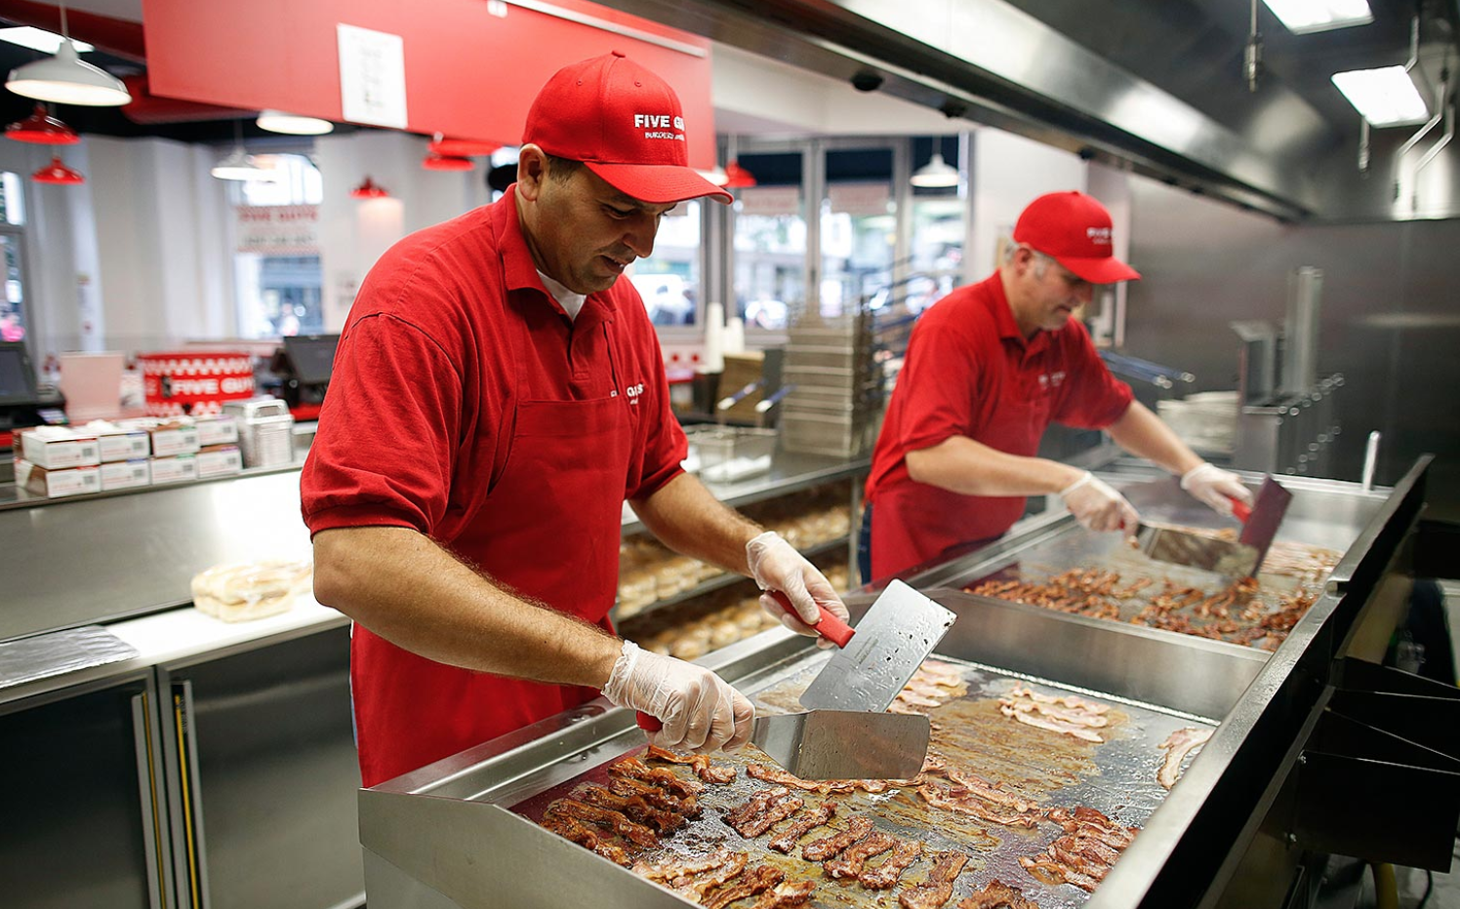
21
Realistic (R)
Cooks, Institution and Cafeteria
Cooks, Fast Food
Dishwashers
O*Net: 35-2011.00
Career Cluster: HOS
Video: Click Here
O*Net: 35-2012.00
Career Cluster: HOS
Video: Click Here
O*Net: 35-9021.00
Career Cluster: HOS
Video: Click Here

Slide 22



22
Realistic (R)
Mail Clerks and Mail Machine Operators, Except Postal Service
Production Workers, All Other
Boilermakers
O*Net: 47-2011.00
Career Cluster: MAN
Video: Click Here
O*Net: 51-9199.00
Career Cluster: MAN
Video: Click Here
O*Net: 43-9051.00
Career Cluster: BUS
Video: Click Here

Slide 23

23
Realistic (R)
Stonemasons
O*Net: 47-2022.00
Career Cluster: A/C
Video: Click Here

Slide 24
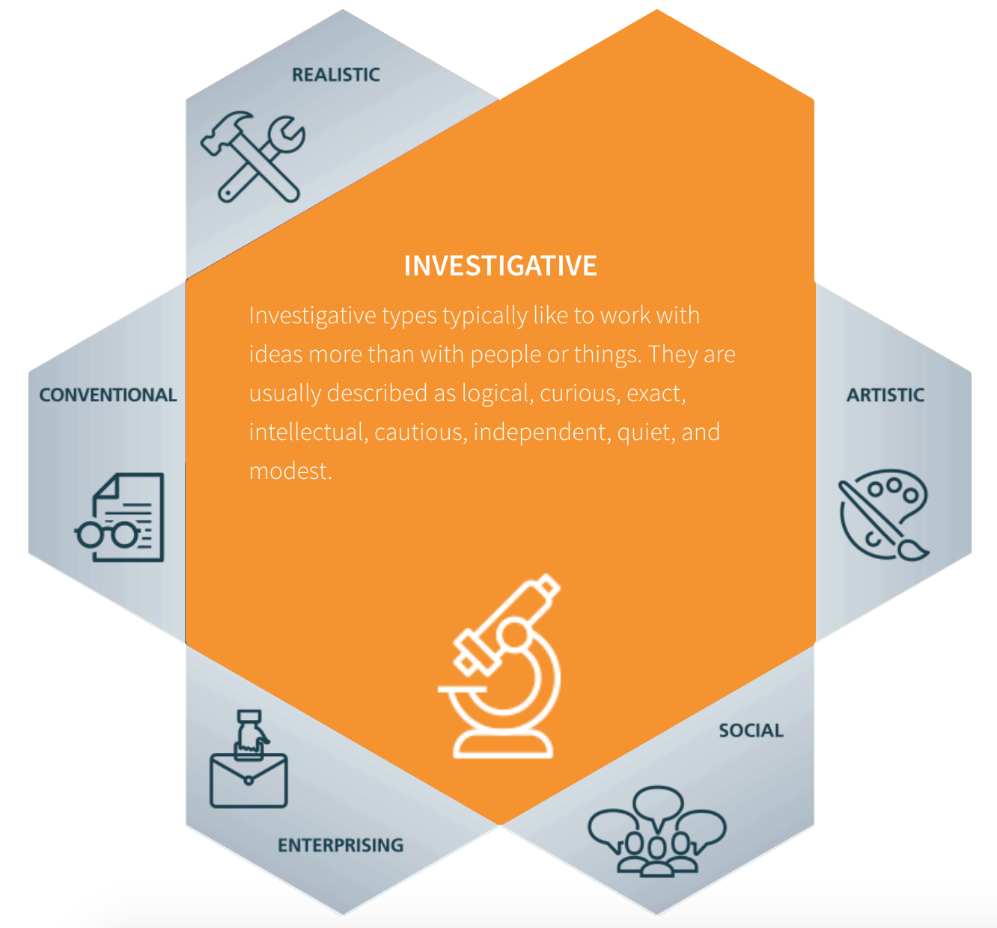
24
Investigative (I)

Slide 25

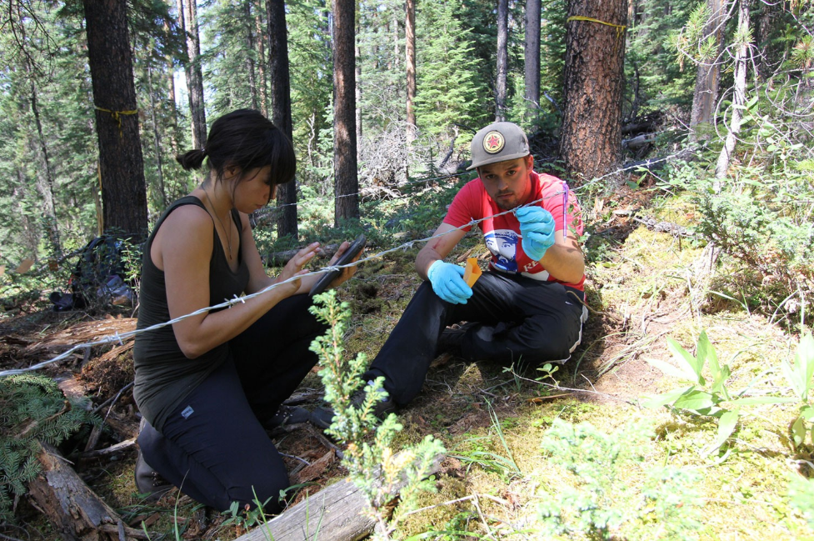
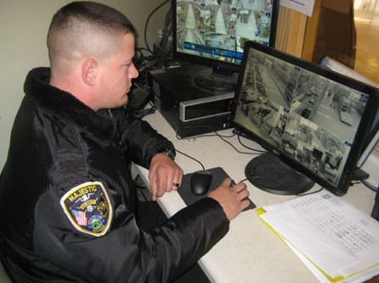
25
Investigative (I)
Non-Destructive Testing Specialists
Forest and Conservation Technicians
Retail Loss Prevention Specialists
O*Net: 17-3029.01
Career Cluster: STEM
Video: Click Here
O*Net: 19-4071.00
Career Cluster: AGR
Video: Click Here
O*Net: 33-9099.02
Career Cluster: LAW
Video: Click Here

Slide 26

26
Artistic (A)

Slide 27


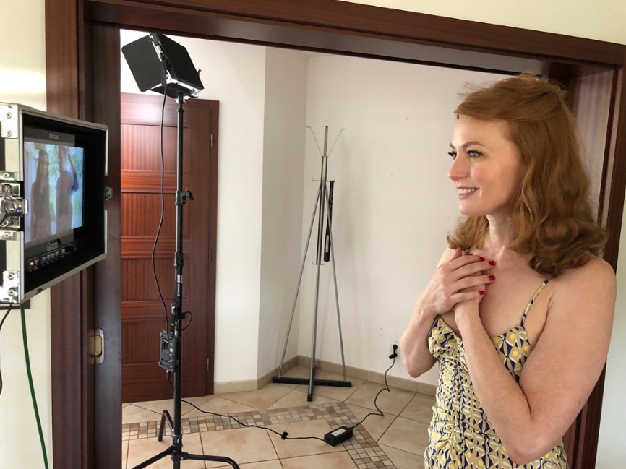
27
Artistic (A)
Painting, Coating, and Decorating Workers
Dancers
Actors
O*Net: 51-9123.00
Career Cluster: MAN
Video: Click Here
O*Net: 27-2031.00
Career Cluster: ART
Video: Click Here
O*Net: 27-2011.00
Career Cluster: ART
Video: Click Here

Slide 28

28
Artistic (A)
Models
O*Net: 41-9012.00
Career Cluster: MKT
Video: Click Here

Slide 29
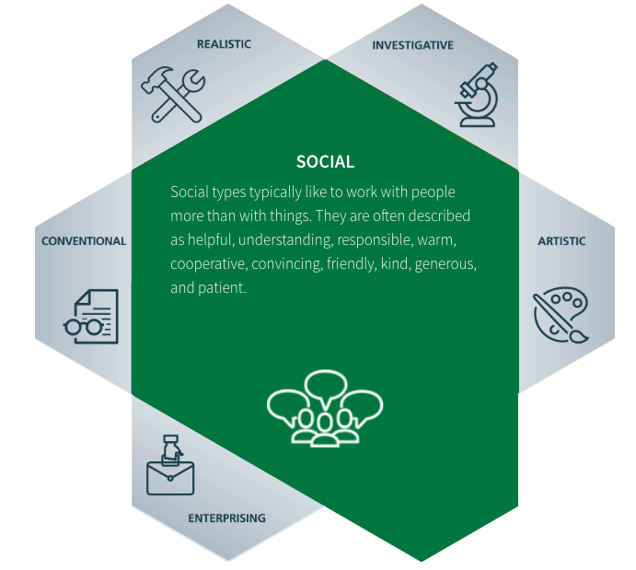
29
Social (S)

Slide 30



30
Social (S)
Locker Room, Coatroom, and Dressing Room Attendants
Amusement and Recreation Attendants
Childcare Workers
O*Net: 39-3091.00
Career Cluster: HOS
Video: Click Here
O*Net: 39-3093.00
Career Cluster: HUM
Video: Click Here
O*Net: 39-9011.00
Career Cluster: HUM
Video: Click Here

Slide 31



31
Social (S)
Personal Care and Service Workers, All Other
Funeral Attendants
Parking Lot Attendants
O*Net: 39-4021.00
Career Cluster: HUM
Video: Click Here
O*Net: 53-6021.00
Career Cluster: TRA
Video: Click Here
O*Net: 39-9099.00
Career Cluster: HUM
Video: Click Here

Slide 32



32
Social (S)
Ushers, Lobby Attendants, and Ticket Takers
Security Guards
Library Assistants, Clerical
O*Net: 33-9032.00
Career Cluster: LAW
Video: Click Here
O*Net: 43-4121.00
Career Cluster: EDU
Video: Click Here
O*Net: 39-3031.00
Career Cluster: HOS
Video: Click Here

Slide 33

33
Social (S)
Fast Food and Counter Workers
O*Net: 35-3023.00
Career Cluster: HOS
Video: Click Here

Slide 34
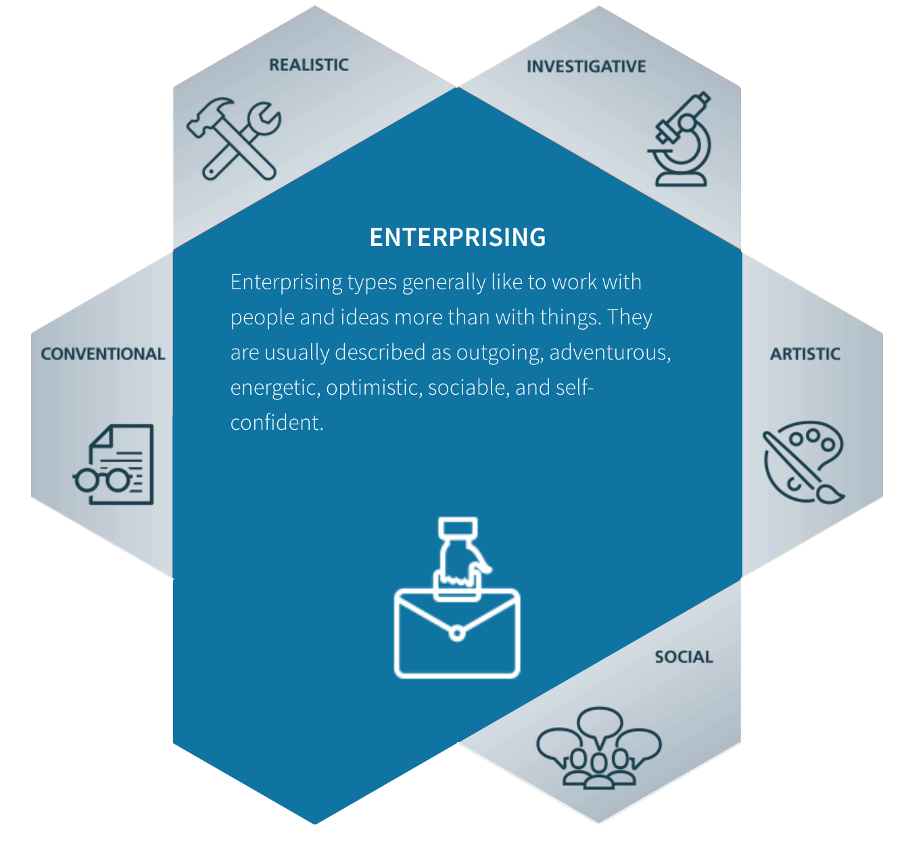
34
Enterprising (E)

Slide 35



35
Enterprising (E)
Public Address Announcers; Media and Communication Workers, All Other
Retail Salespersons
Parts Salespersons
O*Net: 41-2031.00
Career Cluster: MKT
Video: Click Here
O*Net: 27-3099.00
Career Cluster: ART
Video: Click Here
O*Net: 41-2022.00
Career Cluster: MKT
Video: Click Here

Slide 36



36
Enterprising (E)
Umpires, Referees, and Other Sports Officials
Concierges
Crossing Guards
O*Net: 27-2023.00
Career Cluster: HOS
Video: Click Here
O*Net: 39-6012.00
Career Cluster: HOS
Video: Click Here
O*Net: 33-9091.00
Career Cluster: LAW
Video: Click Here

Slide 37


37
Enterprising (E)
Host and Hostesses, Restaurant, Lounge, and Coffee Shop
Telemarketers
O*Net: 41-9041.00
Career Cluster: MKT
Video: Click Here
O*Net: 35-9031.00
Career Cluster: HOS
Video: Click Here

Slide 38

38
Conventional (C)

Slide 39



39
Conventional (C)
Assemblers and Fabricators, All Other
Counter and Rental Clerks
Sewing Machine Operators
O*Net: 51-2099.00
Career Cluster: MAN
Video: Click Here
O*Net: 41-2021.00
Career Cluster: MKT
Video: Click Here
O*Net: 51-6031.00
Career Cluster: MAN
Video: Click Here

Slide 40


40
Conventional (C)
Baristas
Cashiers
O*Net: 35-3023.01
Career Cluster: HOS
Video: Click Here
O*Net: 41-2011.00
Career Cluster: MKT
Video: Click Here

Slide 41
Scoring
41

Slide 42
Scoring
42
RIASEC | Total
Realistic (R)
Investigative (I)
Artistic (A)
Social (S)
Conventional (C)
Strongest Match | Relative Match

Slide 43
References
43
Luft, P. (2012). Career development theories for transition planning. In R. W. Flexer, R. M. Baer, P. Luft, & T. J. Simmons (Eds.), Transition planning for secondary students with disabilities (4th ed., pp. 67-91). New York City, NY: Pearson.
Perkmen, S. (2012). Testing the utility of person-environment correspondence theory with instructional technology students in Turkey. Australian Journal of Career Development, 21, 25-35.
U.S. Department of Labor. (2018). Occupational information network (O*Net) online. Retrieved from https://www.onetonline.org/

