Slide 1
Agenda

Slide 2
Agenda 1/30/2023
Why are we here?
Indicator B-12(Early Childhood Transition) Data Submission Procedures.
Roles and Responsibilities:
WISD
Process - Michelle Pogliano
Locals
Process – Michelle Pogliano
WISD Technology – David Spitzley & Stephanie Gabriel
Data TC – Helen Harvin and Nicole Revels
Final data check
Overlay Review & Process – David Spitzley
SRM Files
List of Errors – Stephanie Gabriel

Slide 3
Why are we here?

Slide 4
Indicator B-12 (Early Childhood Transition) Data Submission Procedures
Indicator B-12 is a compliance indicator, and there is a 100 percent compliance target. Any percentage less than 100 percent is considered noncompliant for the child’s resident district, which is responsible for completing and implementing the IEP by the child’s third birthday. Therefore, the resident district is responsible for accurate submission of the following characteristics in the Michigan Student Data System (MSDS) which are used to calculate compliance.

Slide 5
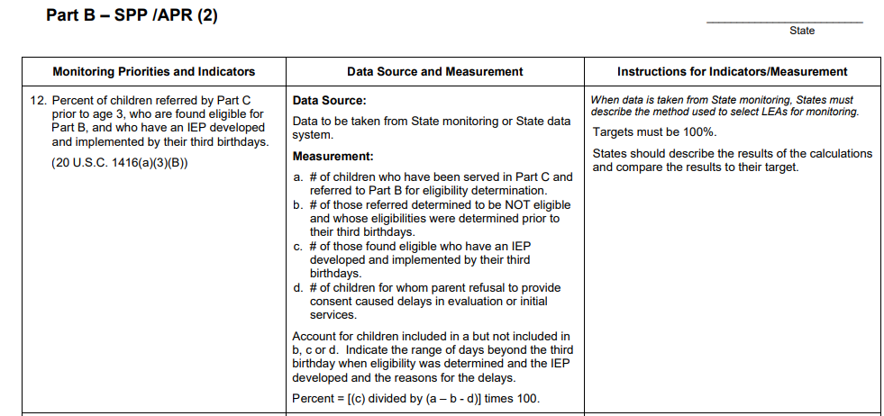
Part B indicator Measurement table
Link to pdf

Slide 6
B-12 Submission to MSDS
B-12 Data Submission
WISD Reporting Responsibilities | Local District Reporting Responsibilities
Part C | Part B
Student’s Date of Birth | Initial IEP Completion Date
Initial Part C/IFSP Referral Date | Timeliness of Initial IEP
*Special Education Exit Reason | Results of Initial IEP
*Special Education Exit Date | Part C Transition Timeliness
 | *Special Education Exit Reason
 | *Special Education Exit Date
*These data fields may be blank if the child did not exit special education. However, in the case of children whose parent revokes consent for the provision of special education and related services prior to a child’s third birthday, the resident district must report a Special Education Exit Date and Special Education Exit Reason with code 31

Slide 7
Roles and Responsibilities
Early On Role
District Role
Both Early-On and District Role

Slide 8
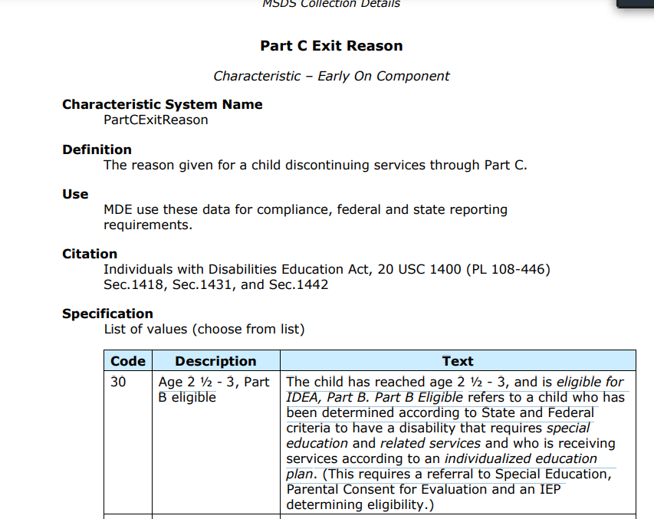
Roles and Responsibilities- Early On Role
WISD Reporting Responsibilities
Part C
Student’s Date of Birth
Initial Part C/IFSP Referral Date
*Special Education Exit Reason
*Special Education Exit Date
At each count period, Fall, Spring and End-of-Year, Early On will pull a report of students from PowerSchool Special Program - Student Information System (PSSP-SIS) who are eligible for both Early On and MMSE who have turned 3 since the last count period.
The report will be found in PSSP >Reporting> Standard Reports> TBD.
***The folder name and the report name will be shared once created.
Early On will verify each of the components attributed to Early On in the chart to the left, are entered for each EO student in (PSSP SIS).
Early On will verify that each component attributed to Early On is also indicated to be uploaded to MSDS.
Any missing information must be entered in to (PSSP-SIS) before the data is uploaded to MSDS.
*NOTE: The certification deadline is typically 5 weeks after the count date.
Early On will share relevant student information with (district personnel/role) at each member district, which has one or more students on the list on a monthly basis.
Early On will indicate on the student list that each record has been checked for completeness in (PSSP SIS) and shared with (district personnel).

Slide 9
Roles and Responsibilities- District Role
(District personnel) will label that student list (report) received from Early On and save it.
Using the student report provided from (Early On), (district personnel) will use (PSSP SIS) to verify each of the components attributed to the district in the chart are entered for each student in (PSSP SIS).
(District personnel) will verify that each component attributed to the district is also indicated to be uploaded to MSDS. Any missing information must be entered in (PSSP SIS) before the data is uploaded to MSDS
The verification deadline is typically 5 weeks after the count date. (District personnel) will indicate on the student list that each record has been checked for completeness in (PSSP SIS).
Local District Reporting Responsibilities
Part B
Initial IEP Completion Date
Timeliness of Initial IEP
Results of Initial IEP
Part C Transition Timeliness
*Special Education Exit Reason
*Special Education Exit Date

Slide 10
Roles and Responsibilities- Both Early-On and District Role
While the data is in the staging area of MSDS (personnel) must review the data to ensure that each component from (PSSP SIS) has been uploaded to the correct field in MSDS.
If any data are missing (personnel) must enter the missing information before the certification deadline.
Upon verification that each field uploaded, note the date of the verification on the student file.

Slide 11
Report in MSDS submission
Local District Reporting Responsibilities
Part B
Initial IEP Completion Date
Timeliness of Initial IEP
Results of Initial IEP
Part C Transition Timeliness
*Special Education Exit Reason
*Special Education Exit Date
MSDS Manual

Slide 12
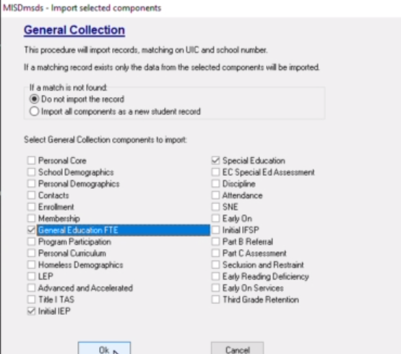
Overlay Review and Process
How to do the overlay
video link
How to do the overlay Instructions
Resources from Macomb ISD
Misdmsds program zip file
MISDMSDS Installation Direction
Misdmsds Documentation
MSDS Collection Manual

Slide 13
List of challenges of why data is not submitted to MSDS correctly

Slide 14
Areas of Challenge of why the student wasn’t in the count submission
Logo on left Side of District’s Document(s) for the Student was-- WISD Logo
Cause:
Preferred method of overlay was not used.
Which missed the Count submission
No District Enrollment Record Profile created
Cause:
Logo on left Side of District’s Document(s) for Student was the District’s Logo
IEP wasn't finalized in a timely matter.
Action:
An Enrollment Record must be created prior to any District Documents opened.
IEP was opened after the 3rd Birthday.
**This sync process take until the following morning.
The District’s Enrollment start date is after the District’s Document(s)
i.e. Eligibility Recommendation should have the District’s logo on it.
IEP Notice page will not have the field available.
Must navigate to the CEPI profile to edit a response: “IEP Held after the child’s third birthday…. “

Slide 15
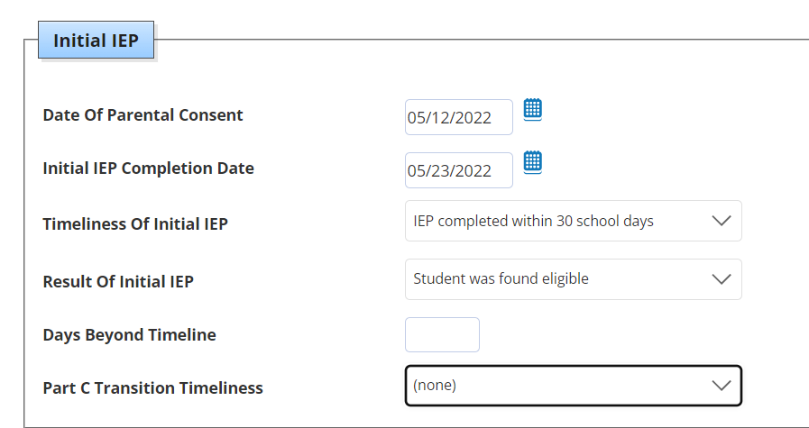
Example of an IEP of a child who is 3-6

Slide 16
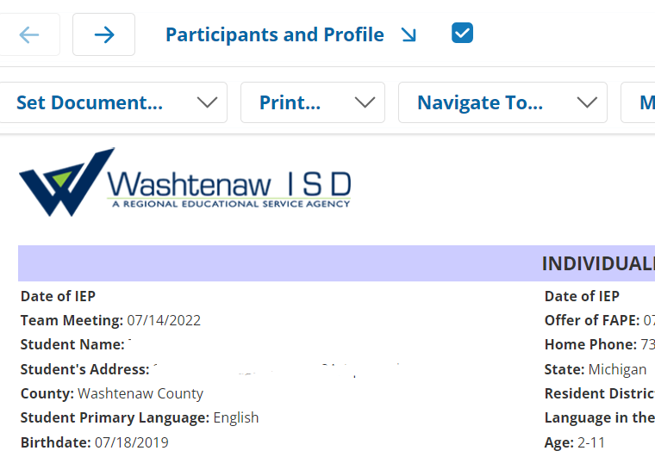
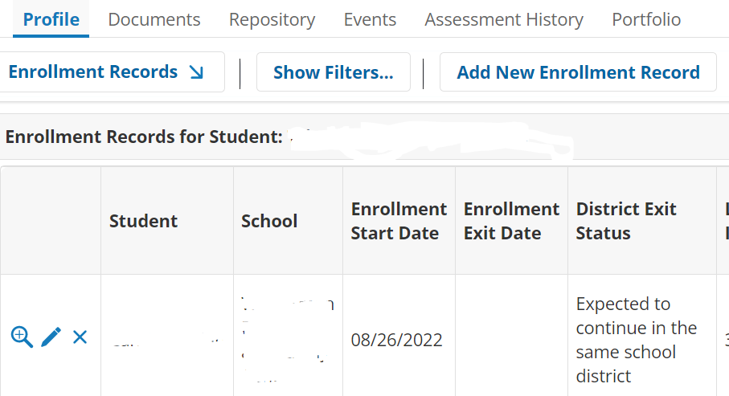
Example of a child’s Enrollment Record where the “Enrollment start date” is after the IEP date

Slide 17
Early On Child Find Procedures Step – by – Step
Early-On Department receives a referral for a student that is eligible for Part C
o Input all student’s demographic information including date of birth and initial Part C date AND Enrollment Record Profile.
Evaluation – Eligibility Determination
Upon eligibility determination, WISD will provide EO services for all students who are residents of local school districts in Washtenaw County except for Ann Arbor.
WISD Early On meets and sends monthly reports to all local districts that contain upcoming MMSE transition age children.
Transition window is between ages 2.3 to 2.9 years.
IFSP must have a transition plan and conference meeting.
Districts preparing to complete a REED MUST create an enrollment record and have an IEP completed and implemented by age 3.
Enrollment records must be completed at least 24 hours prior to REED being open for data sync.
*NOTE: WHEN A DISTRICT COMPLETES A REED, IT MUST HAVE THE DISTRICT’S LOGO IN UPPER LEFT CORNER.
District has 30 school days to complete the evaluation once the REED is signed.
District invites appropriate stakeholders to the MET and IEP meeting.
District holds MET and IEP on or before the child's 3rd birthday. Be sure to finalize.

Slide 18
Question and Answers

